Slide 1
Careers in Pharmacy and the Pharmaceutical Sciences

Slide 2
Pharmacy is a noble profession
Consistently in the top 5 of most trusted professions*
Excellent earning potential
Rigorously tested and licensed
*Gallup annual rating of the honesty and ethics of professions: https://news.gallup.com/poll/388649/military-brass-judges-among-professions-new-image-lows.aspx

Slide 3
Degrees in Pharmacy
Practice Degrees:
Bachelors Degree in Pharmacy (BSPharm)
No longer available as terminal degree
Doctor of Pharmacy (PharmD)
Research Degrees
MSc- multiple areas of focus
PhD- multiple areas of focus
Some schools offer dual degrees
PharmD/MPH, PharmD/MBA

Slide 4
Resident and Fellowship Training
Residencies
Post-graduate year 1: Hospital-based, Community-based, or Managed-care based
Post-graduate year 2: Various specialty areas
Fellowships
Academic / Research
Clinical/Administrative (Health-system)
Non-profit / Government
Public Health / Global Health
Industry
…

Slide 5
Research Areas
Clinical
Medicinal Chemistry
Biopharmaceutics
Outcomes
Pharmacoeconomics
Data Science

Slide 6
Practice Settings

Slide 7
Community Pharmacy Practice
About 30% of pharmacists work in this setting
Key community health resource
Independent vs. Chain vs. Clinic-, Hospital-, or Health-System-based
Practice is seeing a lot of change
Advanced training expanding for pharmacists providing advance clinical services in the community

Slide 8
Hospital or Health-Systems Pharmacy Practice
Many different types of pharmacist positions
Clinical
Operational
Administrative
Leadership
Many settings:
Large academic medical centers
Non-academic health centers
Community hospitals
Small and rural hospitals
Pharmacist receive advanced training tailored to their roles

Slide 9
Inpatient Clinical Specialist
Participate in medical team rounding
Actively involved in medication decisions for patients
Several different models of practice
Specialty expertise in many practice areas:
Cardiology
Critical Care
Emergency Medicine
Infectious Diseases
Pediatrics
Oncology
…

Slide 10
Ambulatory Clinical Specialists
Rapidly growing practice area
Found in health system clinics or private practices
Drug experts in area of specialty
Advanced clinical authority
Example: Collaborative Practice Agreements (CPA) - Pharmacist referral from a licensed provider to order medications, labs, and other clinical tasks

Slide 11
Academic Pharmacy
Teaching responsibilities
Research opportunities
Possible careers:
Professor
Associate dean / administrator
Dean
Pharmacy educator, working with student pharmacists and student technicians

Slide 12
Pharmaceutical Industry
Medical Science Liaison
Medical Affairs
Research
Manufacturing
Regulatory

Slide 13
Other Potential Career Options
Managed Care
Population Health Pharmacy
Specialty Pharmacy
Nuclear Pharmacy
Veterinary Pharmacy
Governmental
Regulatory
Military
Non-Profits

Slide 14
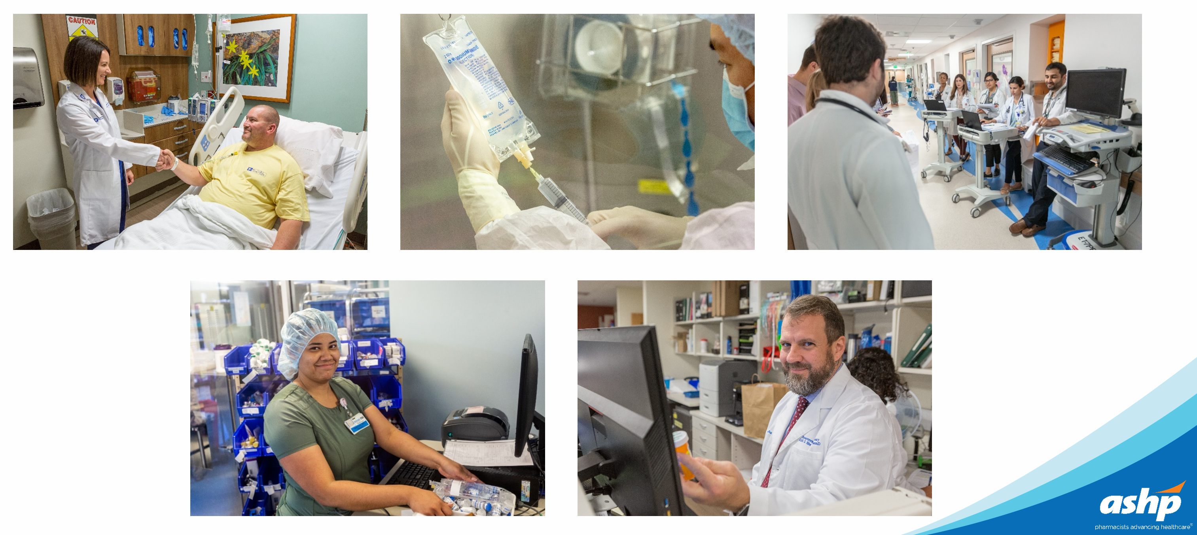
Where there is a patient, there is a pharmacist…

