Slide 1
Policies Approved in the March 2026 ASHP House of Delegates
March 2026

Slide 2
The ASHP House of Delegates
Ultimate authority over ASHP professional policies
One annual session consisting of 2 in-person meetings at the June House of Delegates and 3 virtual meetings (March, May, and November)
The House considers professional policy proposals that have been approved by the Board of Directors
Most of these professional policy proposals are contained in reports from ASHP councils but may come from other component bodies, delegates, or ASHP members

Slide 3
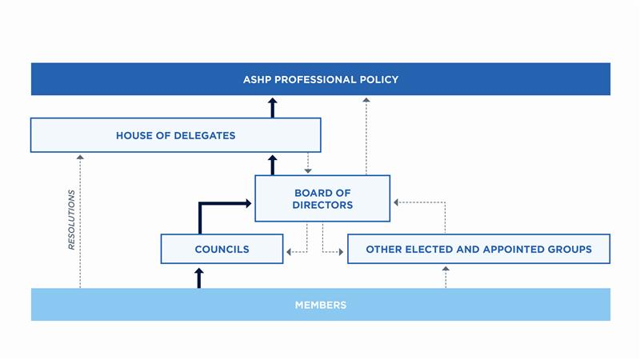
ASHP Policy Process

Slide 4
March 2026 Virtual House of Delegates
The policy recommendations in the following slides were approved at the March virtual House of Delegates.

Slide 5
CEWD: Responsible Integration of Artificial Intelligence in Pharmacy Education and Training
To advocate for the responsible integration of artificial intelligence (AI) into pharmacy education and training programs to support learner development and practice readiness; further,
To advocate for development of competencies for discerning AI-generated content, including strategies to validate the accuracy, credibility, and applicability of information produced by AI systems; further,
To collaborate on the development of standards for AI use in pharmacy education and training.

Slide 6
CEWD: Fostering Leadership Development (Discontinuation)
To discontinue ASHP policy 2104, Fostering Leadership Development, which reads:
  To work with healthcare organization leadership to foster opportunities, allocate time, and provide resources for members of the pharmacy workforce to move into leadership roles; further,
  To encourage leaders to seek out and mentor members of the pharmacy workforce in developing administrative, managerial, and leadership skills; further,
  To encourage members of the pharmacy workforce to obtain the skills necessary to pursue administrative, managerial, and leadership roles; further,
  To encourage colleges of pharmacy and ASHP state affiliates to collaborate in fostering student leadership skills through development of co-curricular leadership opportunities, leadership conferences, and other leadership promotion programs; further,
  To reaffirm that residency programs should develop leadership skills through mentoring, training, and leadership opportunities; further,
  To foster leadership skills for members of the pharmacy workforce, including skills for pharmacists to use on a daily basis in their roles as leaders in patient care.

Slide 7
CPM: Safe Use of Controlled Substances Through Regulatory Reform
To advocate for the reform of the Controlled Substances Act (CSA) to align with contemporary healthcare practice standards, with input from pharmacists and other stakeholders; further,
To urge the Drug Enforcement Administration (DEA) to issue transparent and practical guidance when interpreting and applying laws and regulations related to the CSA and other drug laws that affect patient care; further,
To encourage the DEA and other regulatory agencies to balance regulatory requirements with patient access to medically necessary controlled substances when developing regulations and interpreting and enforcing laws and regulations; further,
To promote collaboration among the DEA, professional associations, and regulatory agencies to identify and reduce: 1) barriers to patient care; 2) burdens on healthcare workers; and 3) cost of healthcare delivery in the establishment and enforcement of controlled substance laws and regulations.

Slide 8
CPM: Pharmacy Leadership of Infusion Services
To encourage healthcare organizations to engage pharmacists and pharmacy leaders in the development and management of infusion service lines; further,
To advocate for payment commensurate with the level and complexity of care and services provided to support sustainable infusion business models; further,
To advocate for the elimination of site of care restrictions to ensure patient preference and continuity of care in infusion services; further,
To encourage use of technology that integrates with patient medical records to enhance medication safety and streamline authorization and adjudication processes.

Slide 9
CPM: Name Change (Discontinuation)
To discontinue ASHP policy 9411, Name Change, which reads:
  To change the name of the American Society of Hospital Pharmacists, Inc. (ASHP) to the American Society of Health-System Pharmacists, Inc. (ASHP), effective January 1, 1995; further,
  To amend the ASHP Charter, Second Article, by deleting Hospital and substituting Health-System; further,
  To amend and restate the ASHP Bylaws, Article 1.1, to conform to the amended ASHP Charter; further,
  To declare that this Charter amendment is advisable, and direct that the Charter amendment be submitted to the House of Delegates and the membership for consideration.
The ASHP membership approved this action by mail ballot, September 1994.

Slide 10
CPhP: Ready-to-Use Packaging for all Settings (Discontinuation)
To discontinue ASHP policy 0402, Ready-to-Use Packaging for all Settings, which reads:
  To advocate that pharmaceutical manufacturers provide all medications used in ambulatory care settings in unit-of-use packages; further,
  To urge the Food and Drug Administration to support this goal; further,
  To encourage pharmacists to adopt unit-of-use packaging for dispensing prescription medications to ambulatory patients; further,
  To support continued research on the safety benefits and patient adherence associated with unit-of-use packaging and other dispensing technologies.
  (Note: A unit-of-use package is a container--closure system designed to hold a specific quantity of a drug product for a specific use and intended to be dispensed to a patient without any modification except for the addition of appropriate labeling.)

Slide 11
CPhP: ASHP Statement on Reporting Medical Errors (Discontinuation)
To discontinue ASHP policy 0023, ASHP Statement on Reporting Medical Errors, which reads:
  To approve the ASHP Statement on Reporting Medical Errors.

Slide 12
CPuP: Integrity of Pharmacist Provided Health Information
To oppose any governmental restriction on pharmacists' ability to provide evidence-
based health information to patients; further
To urge policymakers to protect pharmacists' professional autonomy in educating patients on medications, public health issues, and emerging scientific developments; further
To oppose the elimination, suppression, manipulation, or politicization of evidence-based public health data and drug safety information by any entity; further
To advocate for legislation that protects scientific integrity and ensures transparency in the dissemination of public health information; further
To affirm that pharmacists are trusted and reliable medication experts and have the professional responsibility to disseminate evidence-based, health information to patients and communities.

Slide 13
CPuP: Pharmacist Engagement in and Payment for Telehealth (Discontinuation)
To discontinue ASHP policy 2141, Pharmacist Engagement in and Payment for Telehealth, which reads:
  To advocate for pharmacists’ provision of telehealth services in all sites of care; further,
  To advocate that reimbursement for pharmacists’ provision of telehealth services be commensurate with the complexity and duration of service and consistent with other healthcare providers.

Slide 14
COT: Deregulation of Prescription Drugs
To oppose legislation or regulations that permit reclassification of prescription medications to over-the-counter (OTC) status outside of the established Food and Drug Administration (FDA) review and approval process.

Slide 15
COT: Drug Dosing in Conditions that Modify Pharmacokinetics and Pharmacodynamics
To encourage research on the pharmacokinetics and pharmacodynamics of drugs in acute and chronic conditions; further,
To encourage drug product manufacturers and other stakeholders to conduct and publicly report pharmacokinetic and pharmacodynamic research in pediatric, adult, geriatric, and patients at the extremes of weight to facilitate safe and effective dosing of drugs in these patient populations; further,
To advocate healthcare provider education and training that facilitate optimal patient-specific dosing in populations of patients with altered pharmacokinetics and pharmacodynamics; further,
To support development and use of standardized models, laboratory assessment, genomic testing, utilization biomarkers, and electronic health record documentation of pharmacokinetic and pharmacodynamic changes in acute and chronic conditions.
This policy will supersede ASHP policy 1804

Slide 16
COT: Direct-to-Consumer Clinical Genetic Tests
To support research to validate and standardize genetic markers used in direct-to-consumer clinical genetic tests and guide the application of test results to clinical practice; further,
To encourage the Food and Drug Administration (FDA) to continue to regulate direct-to-consumer clinical genetic tests as medical devices and work with the National Institutes of Health to evaluate and approve direct-to-consumer clinical genetic tests; further,
To advocate that direct-to-consumer clinical genetic tests be provided to consumers through the services of appropriate healthcare professionals who order tests from laboratories certified under the Clinical Laboratories Improvement Amendments of 1988 (CLIA); further,
To support FDA policies and procedures regarding advertising of direct-to-consumer clinical genetic tests, including the following requirements: (1) the relationship between the genetic marker and the disease or condition being assessed is clearly presented, (2) the benefits and risks of testing are discussed, (3) such advertising is provided in an understandable format, at a level of health literacy that allows the intended audience to make informed decisions, and includes a description of the established patient-healthcare provider relationship as a critical source for information about the test and interpretation of test results; and (4) how patient information is collected, protected, shared, and used; further,
To encourage health systems to create policies and procedures addressing direct-to-consumer genetic testing results as it relates to confirmatory testing, integration of genomic information into the healthcare record, genetic counseling, and clinical decision-making; further,
To encourage pharmacists to educate consumers and clinicians on the potential risks and benefits of direct-to-consumer clinical genetic tests for disease diagnosis and decisions involving drug therapy management.
This policy will supersede ASHP policy 2101

Slide 17
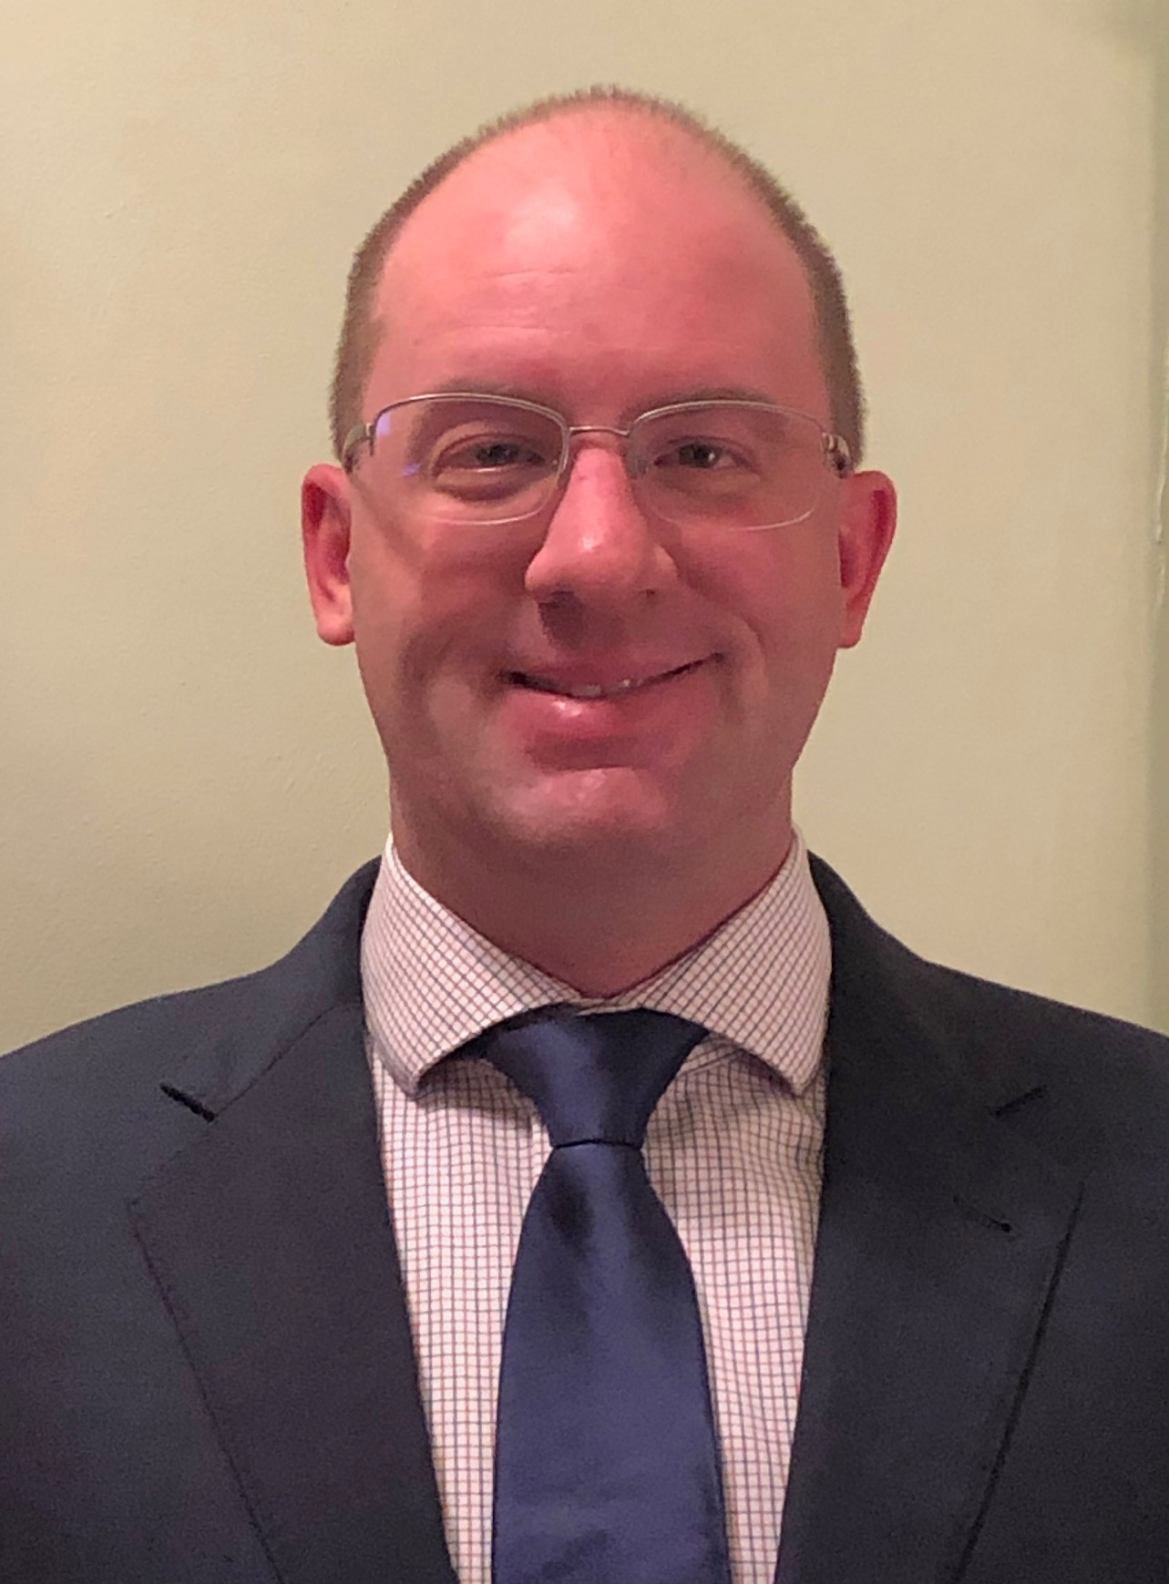
Questions or Suggestions?
Feel free to contact:
Jesse Hogue, Chair, ASHP House of Delegates:
hodchair@ashp.org
ASHP policy website: https://www.ashp.org/Pharmacy-Practice/Policy-Positions-and-Guidelines/

