Slide 1
Student Pharmacy Forecast Workshop: Trends that Will Shape Your Future
Presented by ASHP’s
Section of Pharmacy Practice Leaders

Slide 2

Special Acknowledgements
Forecast 2023 Advisory Committee
Chapter authors
Forecast Panelists (FPs) who responded to the survey
Notes:
Can you please replace the ASHP Foundation logo? This one is blurry on a big screen.

Slide 3
Acknowledgements for Preparing Workshop Slides: Section of Pharmacy Practice Leaders
Advisory Group for New and Emerging Leaders
Conner Ball, PharmD, MBA
HSPAL Resident
University of Michigan Health – Ann Arbor, MI
Mary Jane Braham, PharmD
HSPAL Resident
WVU Medicine – Morgantown, WV
Michelle Carrasquillo, PharmD, MS
Pharmacy Manager
BayCare Health System – Lutz, FL
Nicholas Senne, PharmD
HSPAL Resident
Abbott Northwestern Hospital/Allina Health – Minneapolis, MN
Ashley Sidebottom, PharmD, MBA
HSPAL Resident
Baylor St. Luke's Medical Center – Houston, TX

Slide 4

Objectives
Introduce and provide background on the Pharmacy Forecast Report
Discuss survey questions and results from each domain of the report
Apply key trends to case study activities

Slide 5
Pharmacy Forecast
Purpose
To improve the effectiveness of leaders in hospital and health-system pharmacy practice
ASHP Foundation. http://www.ashpfoundation.org/MainMenuCategories/CenterforPharmacyLeadership/Pharmacy-Forecast (accessed 2023 Mar 03).

Slide 6
Pharmacy Forecast: Overview
Predicts developments in general themes likely to challenge pharmacy leaders in hospitals and health-systems over the coming 5 years
Presents authoritative, actionable strategic recommendations to pharmacy practice leaders
Reports survey results of trend watchers and leaders in health-system pharmacy and analyzes predicted trends
Trend reports from ASHP Research and Education Foundation’s Center for Health-System Pharmacy Leadership
ASHP Foundation. http://www.ashpfoundation.org/MainMenuCategories/CenterforPharmacyLeadership/Pharmacy-Forecast (accessed 2023 Mar 03).

Slide 7
Pharmacy Forecast: Methodology
Appointed Forecast Panel (FP) completes a questionnaire
Survey asks likelihood of certain trends occurring over next five years
Experts recruited to write a brief chapter for each domain
Each chapter presents the survey results, authors assessment of predictions and strategic recommendations
ASHP Foundation. http://www.ashpfoundation.org/MainMenuCategories/CenterforPharmacyLeadership/Pharmacy-Forecast (accessed 2023 Mar 03).
Notes:
Slide title is not editable. Would like slide title to say: Pharmacy Forecast Methodology

Slide 8
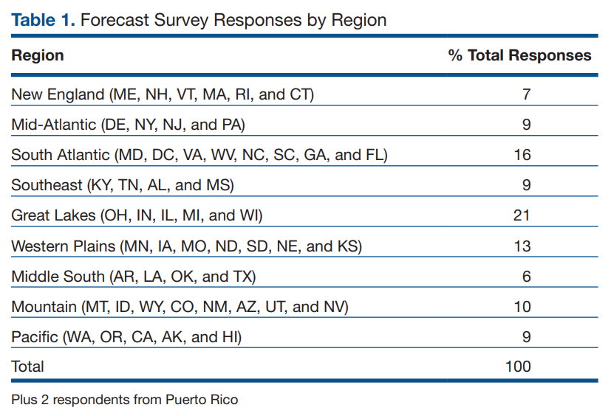
Pharmacy Forecast: Representation
ASHP Foundation. http://www.ashpfoundation.org/MainMenuCategories/CenterforPharmacyLeadership/Pharmacy-Forecast (accessed 2023 Mar 03).

Slide 9
2023 Forecast Themes
COVID-19: Lessons Learned Across the Pandemic
Regaining Trust in Public Health
Addressing Health Disparities in Health Systems: From Awareness to Action
Patient-Centric Healthcare Delivery
Reliance on Technology: Opportunities and Risk
Strengthening the Foundation of the Pharmacy Enterprise: Workforce Planning and Optimization

Slide 10
Student Professional Development
How is the forecast relevant for pharmacy students?
Recognizing emerging trends in pharmacy
Providing insights into expected challenges in pharmacy
Promote thought-provoking discussion and research
Serve as topics for journal clubs, topic discussions, presentations, and interview questions

Slide 11
Theme 1:
COVID-19: Lessons Learned Across the Pandemic

Slide 12
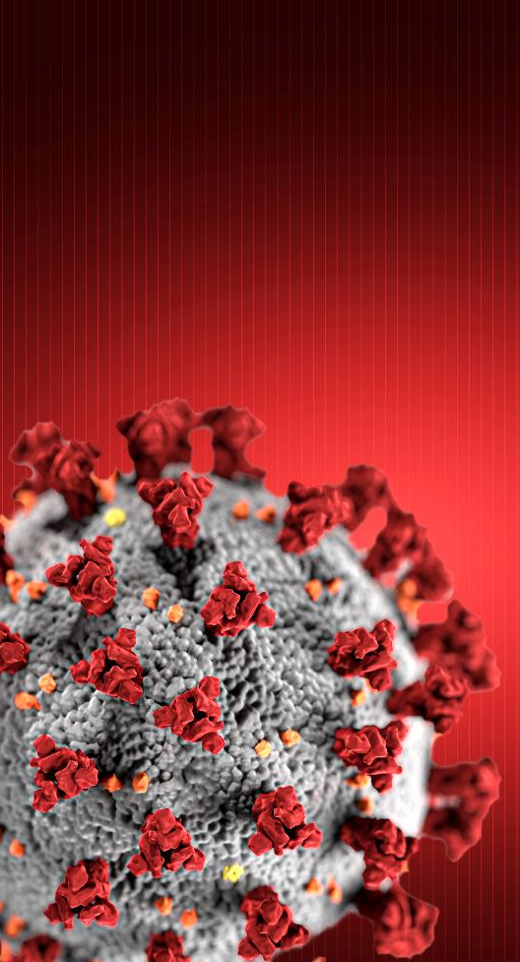
COVID-19: Lessons Learned Across the Pandemic
Coronavirus disease 2019 (COVID-19) pandemic exacerbated and revealed critical issues for health systems
COVID-19 is transitioning from an acute pandemic to a chronic endemic phase
  Health systems must prepare for the next unforeseen threat utilizing lessons learned during the COVID-19 pandemic
Identified challenges have been associated with:
  Emergency preparedness
  Supply chain disruptions
  Workforce shortages
  Leadership vacancies

Slide 13
Theme 1:
Forecast Question 1
How likely is it that the following will occur, by the year 2027, in the geographic region where you work?
25% of health systems will expand drills to prepare for a prolonged state of emergency (e.g. electrical grid collapse, natural disaster, chemical spill).
Very Likely
Somewhat Likely
Somewhat Unlikely
Very Unlikely

Slide 14
Emergency Preparedness and Cybersecurity
The duration of the COVID-19 pandemic heightened health-system leadership concern for prolonged states of emergency (e.g. electrical grid collapse, natural disasters, chemical spills)
External threats such as ransomware attacks increased at the beginning of the pandemic
Prolonged system downtimes are complex and impactful in today’s environment with a broad adoption of electronic health record (EHR) systems and the necessary interfaces with a variety of platforms including:
  Drug libraries and formularies
  Billing systems
  Automated dispensing cabinets

Slide 15
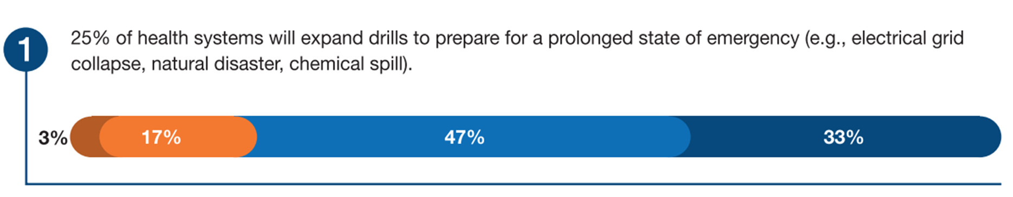
Forecast Response

Slide 16
Theme 1: Forecast Question 2
How likely is it that the following will occur, by the year 2027, in the geographic region where you work?
Health systems will budget 25% more to purchase drugs wholly manufactured (e.g. including active pharmaceutical ingredients), in the United States.
Very Likely
Somewhat Likely
Somewhat Unlikely
Very Unlikely

Slide 17
Theme 1: Forecast Question 3
How likely is it that the following will occur, by the year 2027, in the geographic region where you work?
Health systems will increase their drug and medical supply inventories by 25% to develop and maintain an “emergency stockpile.”
Very Likely
Somewhat Likely
Somewhat Unlikely
Very Unlikely

Slide 18
Theme 1: Forecast Question 4
How likely is it that the following will occur, by the year 2027, in the geographic region where you work?
To mitigate shortages and reduce waste, the FDA will require and evaluate extended stability data for all approved drugs.
Very Likely
Somewhat Likely
Somewhat Unlikely
Very Unlikely

Slide 19
Pharmaceutical Supply Chain
Pharmaceutical Supply Chain disruptions have existed for decades, and health systems routinely monitor and manage inevitable strategies
Drug shortages increased in frequency and duration during the pandemic
Increased likelihood health systems will invest greater resources to develop strategies to mitigate threats:
  Increased domestic production
  Emergency stockpiles
  Research for extending drug stability data
New technologies may lessen or even obliviate the need to make assumptions about specific shortages such as:
  Continuous flow production
  3-D Printing

Slide 20
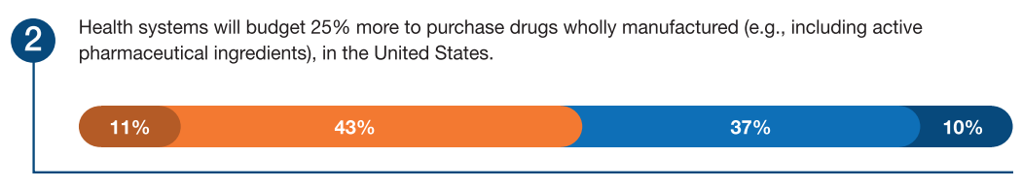
Forecast Response

Slide 21
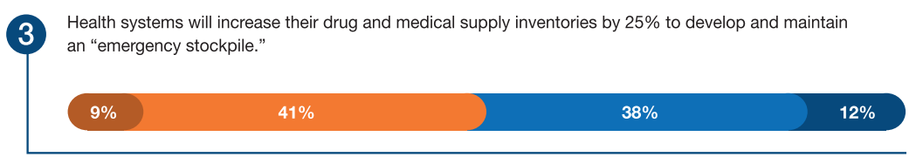
Forecast Response

Slide 22
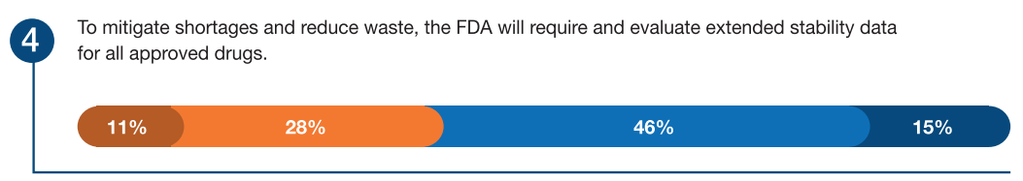
Forecast Response

Slide 23
Theme 1: Forecast Question 5
How likely is it that the following will occur, by the year 2027, in the geographic region where you work?
At least 25% of seasoned leaders of pharmacy health-system enterprises will leave their positions earlier than expected because of increasing stress and complexity of their role.
Very Likely
Somewhat Likely
Somewhat Unlikely
Very Unlikely

Slide 24
Theme 1: Forecast Question 6
How likely is it that the following will occur, by the year 2027, in the geographic region where you work?
Health systems will invest in expanded programs that support behavioral health of their employees.
Very Likely
Somewhat Likely
Somewhat Unlikely
Very Unlikely

Slide 25
Leadership and Succession Planning
The COVID-19 pandemic has led many healthcare professionals to reexamine their purpose and the connection to the mission of organizations
The rise in multiple hospital systems has increased the breadth of responsibilities for healthcare executives while the quest for lean operating has consolidated many organizational leadership structures
Forward-looking work such as strategic planning is a critical element to preserve and engage leaders

Slide 26
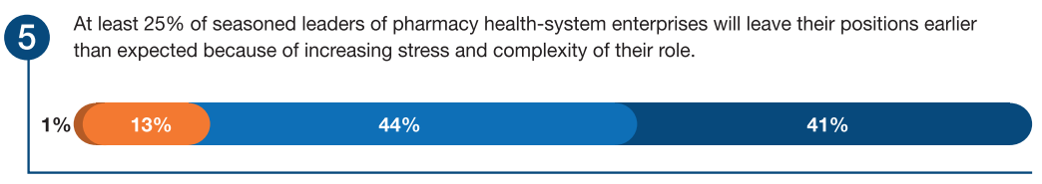
Forecast Response

Slide 27
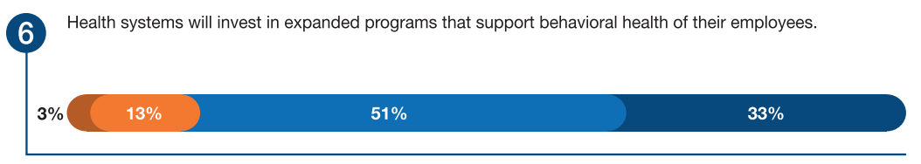
Forecast Response

Slide 28
Theme 1: Forecast Question 7
How likely is it that the following will occur, by the year 2027, in the geographic region where you work?
50% of health systems will have specialized pharmacy staff dedicated to medication management for patients with substance use disorders.
Very Likely
Somewhat Likely
Somewhat Unlikely
Very Unlikely

Slide 29
Patient Care Challenges: Substance Use Disorder Services
Drug overdose deaths in the United States increased by 12.5% from January 2021 to January 2022
Organizations have started offering acute care consultative services for patients during admission with longitudinal outpatient follow-up
Availability of services has not kept pace with the need and demand
  Elimination of the need for clinicians to apply for an X waiver from the Substance Abuse and Mental Health Services Administration to prescribe and administer medications for opioid use will expand availability therapy to patients

Slide 30
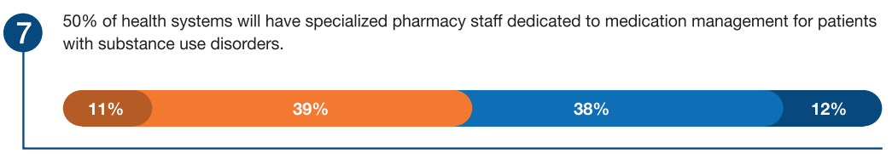
Forecast Response

Slide 31
Strategic Recommendations for Practice Leaders
Develop and apply predictive data analytics capabilities to prospectively monitor drug utilization, predict future consumption, and direct purchasing decisions.
Plan to allocate resources for evolving, advanced manufacturing technology to expand supply chain resiliency and to maximize flexibility in responding to drug shortages.
Consciously engage and monitor teams to ensure work brings individual fulfillment and is aligned with their personal mission, vision, and values and those of the organization.
Optimize pharmacy executive leaders while fostering growth for the next generation of leaders by facilitating effective delegation of operational responsibilities
Assess gaps and resource allocation needed to adequately address SUD management, and invest in specialized pharmacy staff for interprofessional teams

Slide 32
Theme 2:
Regaining Trust in Public Health

Slide 33

Regaining Trust in Public Health
Trust in public health institutions has been declining over the past decades
  Early 1900s: Bubonic plague outbreak
  1918: Influenza pandemic
  2019: COVID-19 pandemic
Reasons for mistrust include:
  Lack of confidence in the government
  Misinformation and conspiracy theories spread through traditional and social media
  Suspect profit motivates of healthcare companies
  Political polarization
  Misinformation propagated by individuals including health professionals
Health systems and health professionals shaping the future of the United States public health system must work diligently to address the lack of trust

Slide 34
Theme 2: Forecast Question 1
How likely is it that the following will occur, by the year 2027, in the geographic region where you work?
Health systems will invest in a systematic effort or program to regain consumer trust in scientific evidence, healthcare professionals, and the healthcare system itself.
Very Likely
Somewhat Likely
Somewhat Unlikely
Very Unlikely

Slide 35
Theme 2: Forecast Question 5
How likely is it that the following will occur, by the year 2027, in the geographic region where you work?
At least 50% of state health professional licensing boards will develop and exercise regulations to discipline professionals that spread medical misinformation.
Very Likely
Somewhat Likely
Somewhat Unlikely
Very Unlikely

Slide 36
Distribution of Accurate Medical Information
Dissemination of inaccurate information prevalent in the COVID-19 pandemic
Coordinated campaigns organized to disseminate inaccurate information about vaccines
Dramatic increase in the dissemination of COVID-19 vaccine misinformation by physicians and other healthcare processionals
Next Steps:
  Health system partnerships with public health departments, health plans, and other health systems to promptly provide succinct and practical responses to health misinformation
  Provider and facilitate access to fact-based information in easy-to-understand and translated formats that are easy for consumers to access
  Continued health system efforts to curb the spread of medical misinformation by clinicians in their system

Slide 37
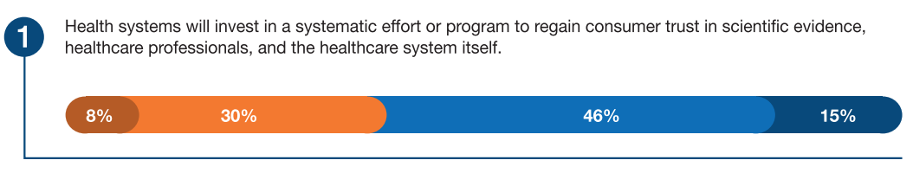
Forecast Response

Slide 38
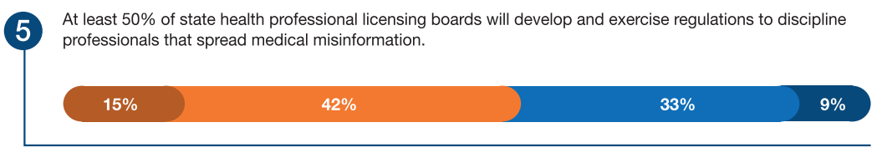
Forecast Response

Slide 39
Theme 2: Forecast Question 2
How likely is it that the following will occur, by the year 2027, in the geographic region where you work?
Health systems will form or partner with a new entity to serve as a centralized clearing house, independent of the FDA, to gather real-world evidence and conduct evidence-based evaluations of approved drugs used for unapproved indications.
Very Likely
Somewhat Likely
Somewhat Unlikely
Very Unlikely

Slide 40
Theme 2: Forecast Question 6
How likely is it that the following will occur, by the year 2027, in the geographic region where you work?
There will be a restructuring of the FDA to increase autonomy and shield the agency from outside influences (e.g. political interests, patient lobbying groups, and the pharmaceutical industry).
Very Likely
Somewhat Likely
Somewhat Unlikely
Very Unlikely

Slide 41
Perceptions of Government Regulatory Bodies and Public Health Agencies
Partnerships with health systems and new (non-FDA) entities exist and increased during the COVID-19 pandemic (e.g., FDA and CDC collaboration with Kaiser Permanente, the Department of Veterans Affairs, and Marshfield Clinic)
Conducted studies on FDA-approved agents for repurposed indications related to the COVID-19 pandemic
Necessary to address external influencers that could sway the FDA’s decision-making processes including:
  Special interest groups
  Pharmaceutical industry
  For-profit healthcare systems

Slide 42
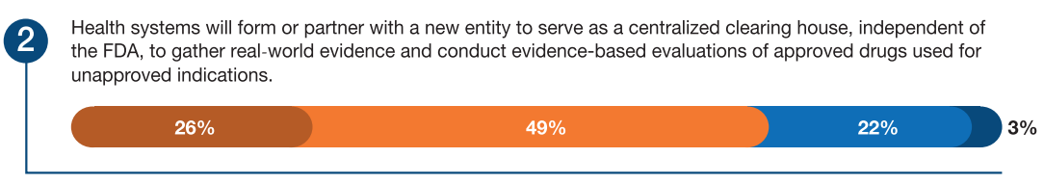
Forecast Response

Slide 43
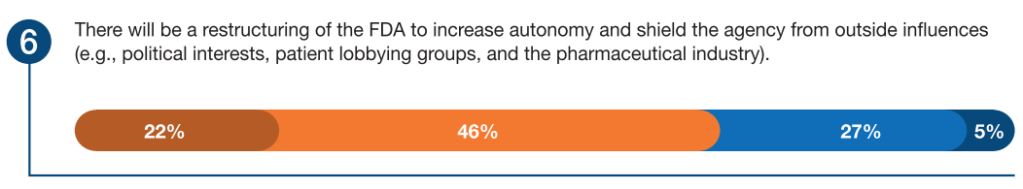
Forecast Response

Slide 44
Theme 2: Forecast Question 3
How likely is it that the following will occur, by the year 2027, in the geographic region where you work?
The Supreme Court will address the right of healthcare professionals to exercise professional judgement and discretion.
Very Likely
Somewhat Likely
Somewhat Unlikely
Very Unlikely

Slide 45
Theme 2: Forecast Question 4
How likely is it that the following will occur, by the year 2027, in the geographic region where you work?
50% of health systems will have a defined grievance process for when a physician declines to prescribe or dispense, respectively, a medication based on their professional judgement and discretion.
Very Likely
Somewhat Likely
Somewhat Unlikely
Very Unlikely

Slide 46
Theme 2: Forecast Question 7
How likely is it that the following will occur, by the year 2027, in the geographic region where you work?
75% of health systems will execute strategies (e.g. code of conduct rules) to ensure accurate health information is conveyed by its providers.
Very Likely
Somewhat Likely
Somewhat Unlikely
Very Unlikely

Slide 47
Medical Decision-Making
Health systems must:
Defend the value of healthcare providers’ professional expertise and judgement
Enhance access of programs that support evidence-based practices for prescribing medications for given disease states to patient populations
Provide evidence supporting a provider or pharmacist decision to decline to prescribe or dispense an agent that should be readily available for people in society to view
Develop systems that receive and address patient grievances to ensure that patients are heard while still addressing medical misinformation

Slide 48
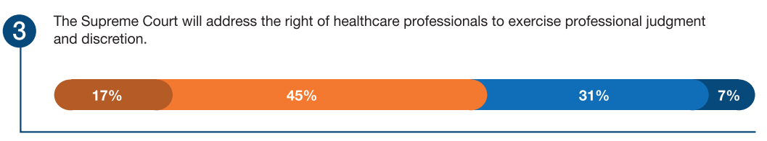
Forecast Response

Slide 49
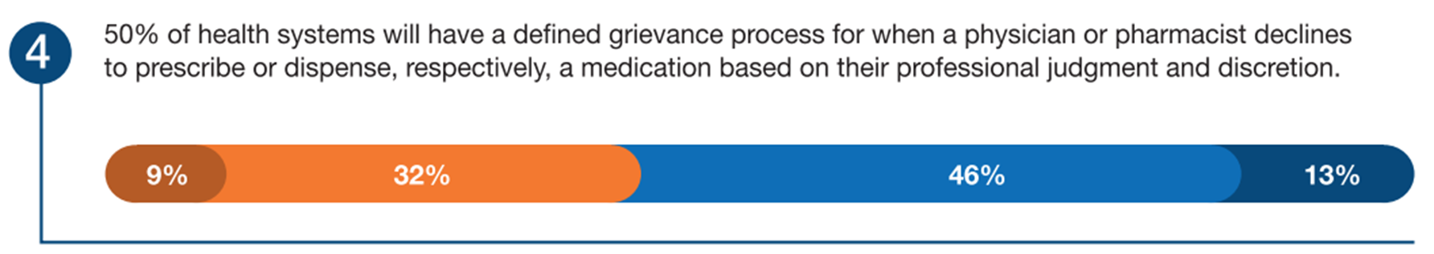
Forecast Response

Slide 50
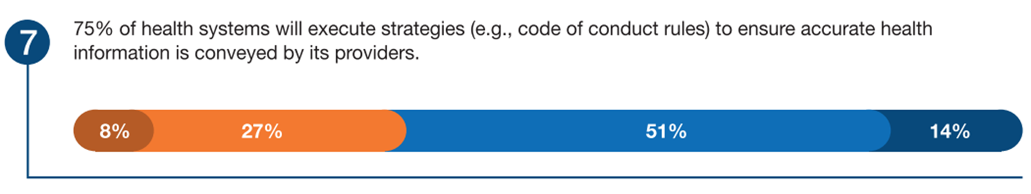
Forecast Response

Slide 51
Theme 2: Forecast Question 8
How likely is it that the following will occur, by the year 2027, in the geographic region where you work?
75% of health systems will partner with or expand partnerships with community organizations to increase trust in public health measures to prevent disease (e.g., the importance of childhood vaccinations).
Very Likely
Somewhat Likely
Somewhat Unlikely
Very Unlikely

Slide 52
Partnerships with Community Organizations
Pharmacists are well positioned to partner with local and state health departments and community organizations.
Benefits of partnerships:
  Improve public trust of healthcare providers by increasing interactions between providers and community members
  Address specific areas to improve public health
  Promote good exercise, nutrition, and preventative care

Slide 53
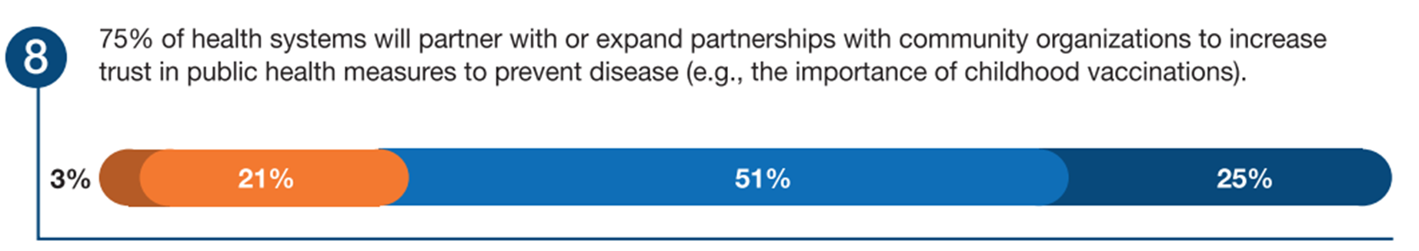
Forecast Response

Slide 54
Strategic Recommendations for Practice Leaders
Strengthen partnerships with local, state, and federal health programs to develop or expand public health programs to address health misinformation
Ensure that providers have access to up-to-date public health recommendations and related medical information
Utilize existing technology and media platforms for boarder visibility as a trusted source of health information to the community to combat medical disinformation.
Implement programs to rapidly identify medical misinformation and enforce grounds for discipline when misinformation is promoted by health-system employees.
Take steps to ensure that providers are trusted messengers. Patients want a bidirectional relationship with their care teams, and they want clinicians to act in their best interests.
Proactively address patient concerns resulting from medical misinformation (e.g., requesting that providers prescribe inappropriate treatments) and devise better methods to engage patients.

Slide 55
Theme 3:
Addressing Health Disparities in Health Systems: From Awareness to Action

Slide 56

Addressing Health Disparities in Health Systems:
From Awareness to Action
Health disparities are commonplace among historically marginalized groups
  Racial and Ethnic Minorities
  LGBTQ+
  Rural Communities
  Women
Health systems must acknowledge, understand, and mitigate:
  The social determinants of health
  Barriers to healthcare contributing to inequities in patient outcomes

Slide 57
Theme 3: Forecast Question 1
How likely is it that the following will occur, by the year 2027, in the geographic region where you work?
Health systems will double their capacity (e.g. the number of providers and available appointments) to deliver mental health services.
Very Likely
Somewhat Likely
Somewhat Unlikely
Very Unlikely

Slide 58
Theme 3: Forecast Question 2
How likely is it that the following will occur, by the year 2027, in the geographic region where you work?
The demand for pharmacists with advanced training in mental health (e.g. board certified in psychiatry) will increase.
Very Likely
Somewhat Likely
Somewhat Unlikely
Very Unlikely

Slide 59
Mental Health
Approximately 20% of American adults experience mental health disorders each year
The prevalence of anxiety and/or depressive symptoms has substantially increased during the COVID-19 pandemic
Nearly 40% of the US population faces a shortage of mental health professionals

Slide 60
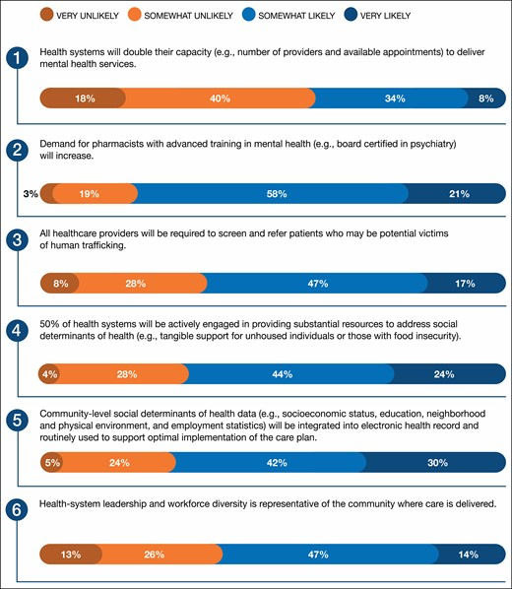
Forecast Response

Slide 61
Forecast Response

Slide 62
Theme 3: Forecast Question 3
How likely is it that the following will occur, by the year 2027, in the geographic region where you work?
All healthcare providers will be required to screen and refer patients who may be potential victims of human trafficking.
Very Likely
Somewhat Likely
Somewhat Unlikely
Very Unlikely

Slide 63
Theme 3: Forecast Question 4
How likely is it that the following will occur, by the year 2027, in the geographic region where you work?
50% of health systems will be actively engaged in providing substantial resources to address social determinants of health (e.g. tangible support for unhoused individuals or those with food insecurity).
Very Likely
Somewhat Likely
Somewhat Unlikely
Very Unlikely

Slide 64
Theme 3: Forecast Question 5
How likely is it that the following will occur, by the year 2027, in the geographic region where you work?
That community-level social determinants of health data (e.g. socioeconomic status, education, neighborhood and physical environment, and employment statistics) will be integrated into electronic health record and routinely used to support optimal implementation into the care plan.
Very Likely
Somewhat Likely
Somewhat Unlikely
Very Unlikely

Slide 65
Social Determinants of Health (SDOH)
Conditions in the environment that affect a wide range of health, functioning, and quality-of-life outcomes and risks
Home environment
Community environment
Work environment
Social environment
Schooling
Age

Slide 66
Forecast Response

Slide 67
Forecast Response

Slide 68
Forecast Response

Slide 69
Theme 3: Forecast Question 6
How likely is it that the following will occur, by the year 2027, in the geographic region where you work?
That health system leadership and workforce diversity is representative of the community where care is delivered.
Very Likely
Somewhat Likely
Somewhat Unlikely
Very Unlikely

Slide 70
Workforce Diversity
Racial and ethnic minorities are generally underrepresented in healthcare professions and health-system leadership
  Racial/ethnic concordance between providers and patients is associated with improved communication and patient satisfaction
  Diverse workforce and C-suite is vital to improving access and quality of care
Innovative recruitment, retention, and development strategies are needed to diversify the future workforce

Slide 71
Forecast Response

Slide 72
Strategic Recommendations for Practice Leaders
Create and implement a proactive, multimodal plan to eliminate health disparities and promote health equity in their communities.
Training of healthcare professionals should include utilization of SDOH to reduce health disparities and improve patient outcomes.
Develop and implement standardized SDOH data collection and ongoing use, including integration into the EHR.
Expand mental health provider recruitment and training opportunities.
Provide training to healthcare providers on how to screen and refer patients who may be potential victims of human trafficking.
Develop and implement innovative strategies to recruit, retain, and develop a pipeline of diverse talent across healthcare professions.

Slide 73
Theme 4:
Patient-Centric Healthcare Delivery

Slide 74

Patient-Centric Healthcare Delivery
Patient-centric healthcare is the delivery of safe, effective, efficient care based on patients’ needs and agnostic sites of care, or simply stated: healthcare without walls.
Driving Forces:
  Aging of baby boomer population
  Increased chronic disease prevalence
  Increased healthcare costs
  Consumer preference for stakeholdership in their care
  Vertical integration of healthcare systems
  Payer policy and drive for non-traditional care

Slide 75
Theme 4: Forecast Question 4
How likely is it that the following will occur, by the year 2027, in the geographic region where you work?
Payers will shift 50% of hospital- and health system-based infusion services (e.g., chemotherapy, chronic infusion treatment) to other, lower cost of care settings (e.g., physician practice, private, network infusion center, and infusions at home).
Very Likely
Somewhat Likely
Somewhat Unlikely
Very Unlikely

Slide 76
Healthcare Without Boundaries and Pharmacy Without Walls
Alternative sites of care such as home infusion and ambulatory surgery centers have growing bodies of literature demonstrating positive outcomes with hospital-at-home care
Expanding innovation in health care delivery and business relationships to deliver healthcare services
Increased pressure from insurance reimbursement trends to transition care to outpatient settings

Slide 77
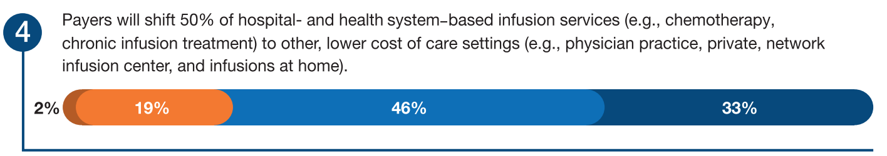
Forecast Response

Slide 78
Theme 4: Forecast Question 7
How likely is it that the following will occur, by the year 2027, in the geographic region where you work?
With the expanded use of aging in place, there will be an increased demand for team-based pharmacy services for homebound individuals.
Very Likely
Somewhat Likely
Somewhat Unlikely
Very Unlikely

Slide 79
Telehealth
Growing evidence supports positive clinical, quality, and financial outcomes from pharmacy telehealth services
While it is unlikely that consumers will expect access to pharmacist-provided telehealth services 24/7, telehealth is a platform that can be leveraged for providing services to homebound individuals
Growing number of service line models have been explored for telehealth services, including:
  Emergency medicine
  Remote patient monitoring
  Transitions of care

Slide 80
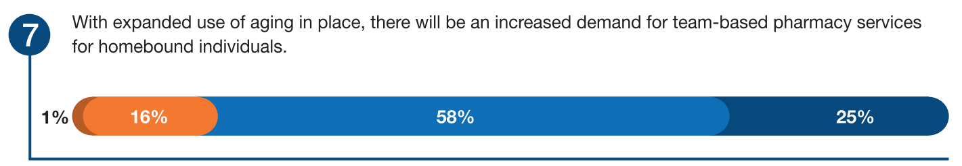
Forecast Response

Slide 81
Theme 4: Forecast Question 8
How likely is it that the following will occur, by the year 2027, in the geographic region where you work?
25% of health systems will establish a pharmacogenomics service.
Very Likely
Somewhat Likely
Somewhat Unlikely
Very Unlikely

Slide 82
Pharmacogenomics
Pharmacogenomics has the potential to optimize therapy, decrease treatment failures, improve outcomes, and decrease potential adverse effects
Pharmacists are uniquely positioned and qualified to incorporate pharmacogenomics into comprehensive medication management
Current improvements to pharmacogenomic payer coverage and reimbursement are ongoing to support program development

Slide 83
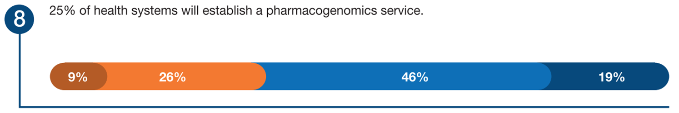
Forecast Response

Slide 84
Strategic Recommendations for Practice Leaders
Engage staff, executive leaders, and payers in demonstrating pharmacy’s roles in medication management regardless of site of care.
Create relationships with post-acute care providers and community pharmacies to ensure safe medication transitions.
Health-system and pharmacy school leaders should collaborate on operational and clinical workforce needs to support acute hospital-at-home services.
Expand patient-centered care to seamlessly provide 24/7 access to pharmacists via telehealth platforms for the spectrum of consumers (e.g., patients, nurses, providers).
Establish pharmacogenomics as a strategic priority and recognize pharmacists as subject matter experts. Establish pharmacogenomics services, in collaboration with other providers, laboratory professionals, and genetic counselors.
Engage in strategic planning for pharmacy services without walls.

Slide 85
Theme 5:
Reliance on Technology: Opportunities and Risks

Slide 86

Reliance on Technology: Opportunities and Risks
Technology is ubiquitous with healthcare and impacts most, if not all, aspects of the 2023 Pharmacy Forecast report
Expanding technology provides opportunities to advance clinical practice, improve patient care, patient safety, and financial viability
Challenges and Opportunities
  Artificial intelligence safety and effectiveness
  Advanced clinical decision support
  Cybersecurity

Slide 87
Theme 5: Forecast Question 1
How likely is it that the following will occur, by the year 2027, in the geographic region where you work?
The FDA will develop standards that regulate the safety and efficacy of clinical decision support driven by artificial intelligence software.
Very Likely
Somewhat Likely
Somewhat Unlikely
Very Unlikely

Slide 88
Artificial Intelligence (AI) Safety and Effectiveness
AI has been defined as “theory and development of computer systems to perform tasks that regularly require human cognition”
Challenges: In clinical decision making there has been issues with accuracy and bias in models leading to errors and inequities in populations less represented, such as children and minorities
The FDA proposed a framework to monitor pre and post marketing performance and allow iterative improvement of algorithms

Slide 89
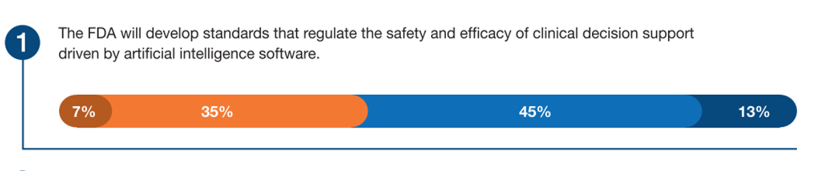
Forecast Response

Slide 90
Healthcare Systems Responsibility with Artificial Intelligence
Validate safety and effectiveness of AI tools
  73% of respondents say health systems will be required to do this
  Only 37% of respondents reported they are prepared to perform this validation
Healthcare systems are responsible for considering diversity in model development and evaluate performance to ensure accuracy is not compromised over time
There will be a need to employ individuals who understand how to assess model performance and error

Slide 91
Theme 5: Forecast Question 3
How likely is it that the following will occur, by the year 2027, in the geographic region where you work?
Health systems will implement AI software that providers relevant medication-related alerts in lieu of a human clinical review and assessment.
Very Likely
Somewhat Likely
Somewhat Unlikely
Very Unlikely

Slide 92
Advanced Clinical Decision Support
Increased AI adoption can support clinical practice, potentially analyzing additional context and patient factors including pharmacogenetic data
This may lead to more relevant medication alerts and limit alert fatigue by improving the positive predictive value of alerts
AI may be utilized in the future for verification or evaluation of low risk and routine orders such as those medications in order sets. This would allow pharmacists to focus more time on clinically complex and high-risk orders

Slide 93
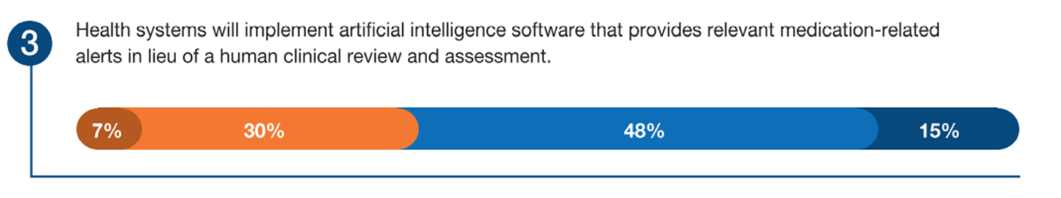
Forecast Response

Slide 94
Theme 5: Forecast Question 6
How likely is it that the following will occur, by the year 2027, in the geographic region where you work?
There will be a critical health-system supply chain shortage as the result of an infrastructure disruption due to a cyber-attack or malware.
Very Likely
Somewhat Likely
Somewhat Unlikely
Very Unlikely

Slide 95
Cybersecurity
Technology provides exciting opportunities but the reliance on technology brings additional risks. Cyberattacks on healthcare systems have increased and continue to grow exponentially
Cyberattacks have put patients' health at risk and cost healthcare organizations millions worldwide
Cybersecurity must be a top priority for any organization

Slide 96
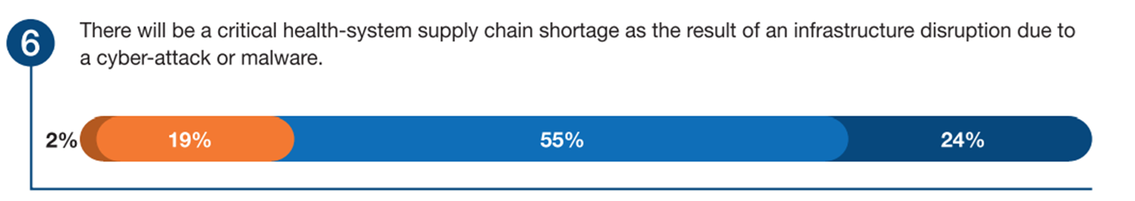
Forecast Response

Slide 97
Strategic Recommendations for Practice Leaders
Prepare departments and professional practice to leverage technology such as AI to continue to advance patient care and pharmacy services
Achieving this requires expertise the potential benefit and harm to result from new technology as well as persistent evaluation and monitoring of the systems
Pharmacy systems must be integrated into the organizations broader cyber security effort to ensure preparedness in identifying and responding to the emergence of new threats

Slide 98
Theme 6:
Strengthening the Foundation of the Pharmacy Enterprise: Workforce Planning and Optimization

Slide 99

Strengthening the Foundation of the Pharmacy Enterprise: Workforce Planning and Optimization
Workforce optimization is an important strategic element for any successful health system pharmacy.
Challenges and opportunities:
Projecting workforce supply/demand during a period of unprecedented workforce vacancies
Anticipating and responding to pharmacy practice model changes resulting from staffing shortages
Changing attitudes about work
Expectations that pharmacy staff will fulfill new, nontraditional pharmacy workforce roles and gaps

Slide 100
Theme 6: Forecast Question 1
How likely is it that the following will occur, by the year 2027, in the geographic region where you work?
Sustained pharmacy enterprise leadership vacancies will drive health systems to fill these roles with non-pharmacists.
Very Likely
Somewhat Likely
Somewhat Unlikely
Very Unlikely

Slide 101
A Changing Workforce
In addition to the ongoing COVID-19 vacancies, trends point to a surge in retirement for those workers who delayed due to the COVID crisis
A surge in leadership vacancies has prompted consideration of non-pharmacists for leadership roles
Professional, regulatory, and operational expertise are key assets for pharmacy executives
Without a pharmacy background, leaders may lack credibility and trust

Slide 102
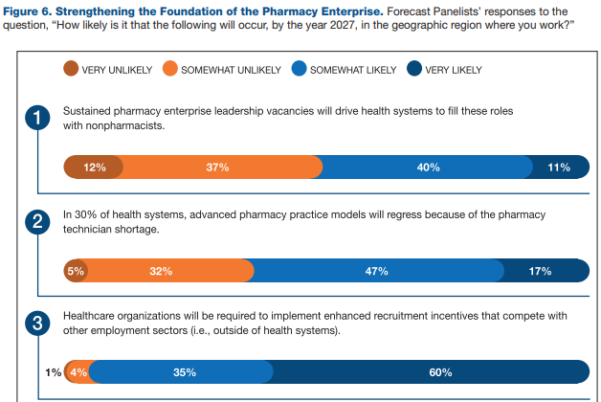
Forecast Response

Slide 103
Theme 6: Forecast Question 3
How likely is it that the following will occur, by the year 2027, in the geographic region where you work?
Healthcare organizations will be required to implement enhanced recruitment incentives that compete with other employment sectors (i.e. outside of health systems)
Very Likely
Somewhat Likely
Somewhat Unlikely
Very Unlikely

Slide 104
Recruitment and Development
Technician shortages continue to overshadow pharmacist shortages, but recruitment, retention, and development of pharmacists is also necessary.
Pharmacy leaders should engage HR and health-system leaders to develop innovative recruitment strategies
Foster active succession planning through recruiting and hiring pharmacists with potential as future leaders
Growth and development of pharmacists remains a priority

Slide 105
Forecast Response

Slide 106
Theme 6: Forecast Question 4
How likely is it that the following will occur, by the year 2027, in the geographic region where you work?
The reduction in applicants to schools and colleges of pharmacy, combined with accelerated pharmacist attrition, will result in a severe shortage of pharmacists.
Very Likely
Somewhat Likely
Somewhat Unlikely
Very Unlikely

Slide 107
Pharmacist Vacancies and Decreasing Pharmacy School Enrollment
National pharmacy school enrollment has declined in recent years to levels not seen since 2003, even though the number of pharmacy schools has more than tripled since that time.
Declining applicant pool has resulted in pressure to reduce enrollment
Fewer graduates may reduce health-system and residency applicants
Health systems must develop effective, long-term strategies to partner with schools/colleges of pharmacy to recruit qualified individuals into pharmacy

Slide 108
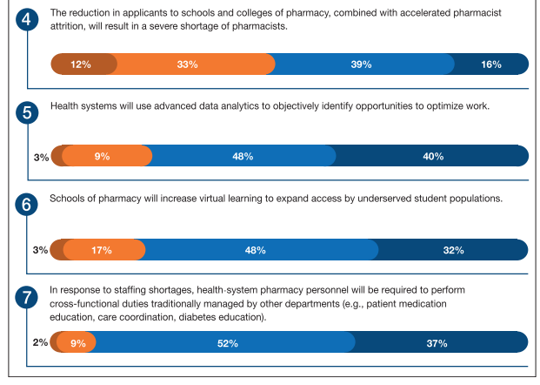
Forecast Response

Slide 109
Theme 6: Forecast Question 2
How likely is it that the following will occur, by the year 2027, in the geographic region where you work?
In 30% of health systems, advanced pharmacy practice models will regress because of the pharmacy technician shortage.
Very Likely
Somewhat Likely
Somewhat Unlikely
Very Unlikely

Slide 110
Pharmacy Workforce Model Changes
Administrators are reporting turnover rates of at least 21% in 2021.
Rising wages for competing entry-level positions continue to make recruitment and retention of technicians more difficult
Health systems must develop an infrastructure that supports long-term sustainability of technician roles
Consider creating novel opportunities, expanding roles, and launching career ladders to support technician growth
Developing novel paths of access to pharmacy school (perhaps through work-and-learn arrangements) may offer new workforce opportunities

Slide 111
Forecast Response

Slide 112
Theme 6: Forecast Question 7
How likely is it that the following will occur, by the year 2027, in the geographic region where you work?
In response to staffing shortages, health system pharmacy personnel will be required to perform cross-functional duties traditionally managed by other departments (e.g., patient medication education, care coordination, diabetes education)
Very Likely
Somewhat Likely
Somewhat Unlikely
Very Unlikely

Slide 113
Pharmacy Workforce Model Changes
Projected shortages of nurses, physicians, and hospital staff may require even further expanded roles of pharmacists.
Pharmacists will likely be expected to do more with less, including medication education, care coordination, and diabetes education
Telepharmacy will likely grow, especially in therapy monitoring, transitions of care, and patient consultations

Slide 114
Forecast Response

Slide 115
A Sustainable Model for Job Satisfaction
Society’s changing attitudes toward how and where we work will continue to impact pharmacy.
Innovative scheduling and remote work solutions are necessary to maintain quality pharmacy services and to mitigate healthcare burnout
Health systems must balance workplace needs with employee wellbeing

Slide 116
Strategic Recommendations for Practice Leaders
Focus on salaries, worker wellness and resilience, and workforce shortages.
Innovative post-pandemic models of care are critical to recruit, retain, and engage students, technicians, and pharmacists
Modernize talent recruitment with market-competitive salaries for all pharmacy positions
Develop succession plans for pharmacists and leaders to address current and future pharmacy practice needs
Create and/or expand training pathways, competencies, and skill sets for specialization in practice areas or leadership roles
Encourage flexible scheduling and hybrid work models to help address employee satisfaction
Establish telehealth care delivery for pharmacy services and ensure pharmacists are directly involved during remote care planning and development

Slide 117
Pharmacy Preparedness
Identifying Gaps
(For Presenters – optional slides for wrap up discussion)

Slide 118
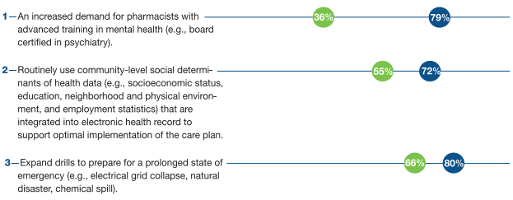
Are We Prepared for Change?
(Selected Questions from Themes) (Presenter see notes)
Notes:
Survey participants were asked to reflect on “preparedness” to select statements and this was compared to “likelihood” of the statement occurring responses to the survey question. This slide shows the gap and can be used to wrap up session on the opportunities and journey that is in front of pharmacy to achieve what the ‘wisdom of the crowd’ predicts will be our practice environment.

Slide 119
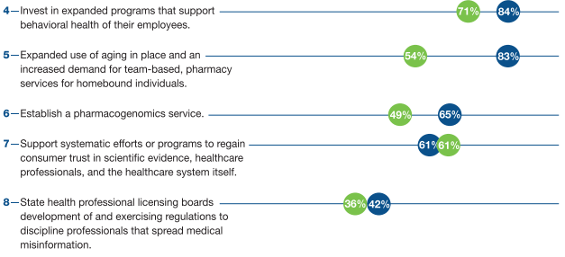
Are We Prepared for Change?
(Selected Questions from Themes) (Presenter see notes)
Notes:
Survey participants were asked to reflect on “preparedness” to select statements and this was compared to “likelihood” of the statement occurring responses to the survey question. This slide shows the gap and can be used to wrap up session on the opportunities and journey that is in front of pharmacy to achieve what the ‘wisdom of the crowd’ predicts will be our practice environment.

Slide 120
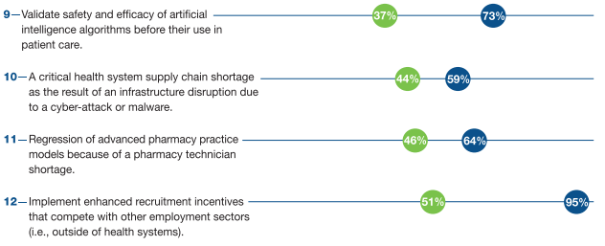
Are We Prepared for Change?
(Selected Questions from Themes) (Presenter see notes)
Notes:
Survey participants were asked to reflect on “preparedness” to select statements and this was compared to “likelihood” of the statement occurring responses to the survey question. This slide shows the gap and can be used to wrap up session on the opportunities and journey that is in front of pharmacy to achieve what the ‘wisdom of the crowd’ predicts will be our practice environment.

Slide 121
Case Study Transition

Slide 122
30 minutes to work on assigned case and answer questions in a small group (4-8 people)
5 minutes per group to present the scenario and answer the questions from the case
Each group should select:
  A person to lead or facilitate discuss among the group
  A person to record discussions/decisions made
  A timekeeper to keep the group on task
  One or two presenters

Slide 123
Large Group Wrap-Up

Slide 124
Conclusion
The pharmacy forecast improves the effectiveness of leaders in hospital and health-system pharmacy practice
The forecast allows for students or other pharmacy professionals to better understand the emerging trends and predicted challenges
Pharmacists are positioned to improve access to care on multiple fronts associated with population health, technology and data, and virtual services

Slide 125
Group Q&A

