Slide 1
Pharmacy Student Leadership Development Workshop

Slide 2
Presenter Introductions
First and Last Name
Position or Title
Organization
Email
First and Last Name
Position or Title
Organization
Email

Slide 3
Session Key
Show or Raise Hand
Student Response
Think-Pair-Share
Group Activity
Notes:
Throughout the presentation you will see the following icons, which will be used to guide student engagement and activities:

Slide 4
Where are you in your pharmacy career?
New Practitioner
Student P1
Student P2
Student P3
Student P4
Resident
Other
Show of Hands
Notes:
Before we get started, help me get an idea for who we have in the room.
Raise your hand if you are a P1, P2, P3, P4, NP?
Who already knows what you will do upon graduation for your career?
How many of you think you will work in a hospital or in the health-system such as long-term care facilities, ambulatory care clinics, etc?
Who is considering an academic career? Research? Community pharmacy? Industry?

Slide 5
Do you consider yourself a leader?
YES
MAYBE
NO
Show of Hands
Notes:
If yes, do you consider yourself a big “L” leader (leader with a title) or little “L” leader (leader without a leadership title)?
If no, what is your definition of a leader?

Slide 6
Our Agenda
Compare and contrast leadership and management
Identify career opportunities for pharmacy leaders
Discuss practical methods for developing leadership skills as a student
Designed by the ASHP Section of Pharmacy Practice Leaders in collaboration with the ASHP Pharmacy Student Forum
Notes:
This program is intended to cover five major areas. First, I just want to share with you the agenda for today. I will begin by sharing some definitions, specifically leadership and management, to make sure we are all on the same page.
Next we are going to learn something new! My guess is that although many of you have already decided your career direction, you probably are unaware of the vast options available to you as a pharmacist. I am going to spend some time sharing with you the state of our profession and some of the prospects for your future which you may not have yet considered.
Then, I will discuss some practical ways to build leadership skills now, as a pharmacy student.
Next, I will lead us through active learning exercises to help you learn from other pharmacy students and develop your leadership skills.
Lastly, I will share leadership pearls of wisdom with you for a long, fulfilled career while continuing to advance our profession.
Whether you are interested in a career in health-system (hospital) pharmacy or another area, this workshop is for everyone. I encourage everyone here to keep an open mind and consider how the topics I will cover could impact your career path and career decisions. I firmly believe this material will help you to be successful in any area you choose.

Slide 7
Learning Objectives
Compare and contrast leadership versus management
Describe the relationship between administrative, clinical, and other general and specialty leadership roles
Identify the need for strong leaders in the profession
Discuss methods to develop leadership skills

Slide 8
What is Leadership?
“Leadership is putting the needs of others ahead of our own. It’s not about being “in charge,” it’s about taking care of those “in your charge.” - Simon Sinek
“Developing a vision of a goal that is capable of capturing and sustaining the commitment of the followers.” - Ken Barker
“Leadership is about making others better as a result of your presence and making sure that impact lasts in your absence.” - Sheryl Sandberg
Notes:
What is leadership?
Take a minute to read this definition to yourself. (Pause for a minute.)
What do you think of this definition? What part do you most agree with? How would you define leadership?
Extra definition of leadership:
1- One systematic review defined leadership as the most common conceptualization of leadership revealed in this analysis was an individual who influences or motivates others, often in the achievement of a specific goal.
Reed BN, Klutts AM, Mattingly TJ 2nd. A Systematic Review of Leadership Definitions, Competencies, and Assessment Methods in Pharmacy Education. Am J Pharm Educ. 2019;83(9):7520. doi:10.5688/ajpe7520

Slide 9
Managers vs. Leaders
Focus on systems
Does things right
Administers
Maintains
Accepts reality
Accepts status quo
Short-range view
Eye on bottom line
Climb ladder fast
Focus on people
Does the right thing
Innovates
Develops
Investigates reality
Challenges status quo
Long-range perspective
Eye on horizon
Is ladder on right wall?
Bennis W, Goldsmith J. Learning to Lead: A Workbook on Becoming a Leader. Perseus Books, Reading, MA, 1997, p. 9-10.
Notes:
Summary: A Manager “Carries things Out”, a Leader “Puts first things first”
The important thing to note is that there is a difference between management and leadership. Both are important. Here is the catch –
You can manage and not be a leader or;
You can lead and not be a manager or;
You can manage and be a leader
So, good managers carry things out and are very disciplined. Good leadership put first things first. Do you see yourself as more of a manager or leader, or both?
Why do we need both?

Slide 10
Different Leadership Styles
Goleman D. Leadership That Gets Results. Harvard Business Review Magazine. March-April 2020 p.82-83.
Notes:
There are multiple leadership styles and classification systems… Research by Daniel Goleman suggests that the most effective executives use a collection of distinct leadership styles—each in the right measure, at just the right time. Such flexibility is tough to put into action, but it pays off in performance. And better yet, it can be learned.

Slide 11
Diversity in Pharmacy & Leadership
Diversity covers more than gender, racial or ethnic considerations; it also includes socioeconomic status, age, experience, environmental adaptability, thought processes, and other dimensions.
Zambrano RH. The Value and Imperative of Diversity Leadership Development and Mentoring in Healthcare. Journal of Healthcare Management. 2019;64(6):356–358
Notes:
We need a pipeline of pharmacists that are interested and prepared to serve as leaders within the profession. It is also important that the pipeline of leaders is diverse. Diversity is often thought of in terms of gender, race or ethnicity. Diversity is more broad and encompasses all of the ways we are different and similar to one another. It includes gender, and race… but also our background, where we grew up, or family structure, our lived experiences, our thought processes, communication styles, and leadership styles.

Slide 12
Diversity in Pharmacy Leadership
The 2014 National Pharmacist Workforce Study (NPWS) reported that the proportion of females in pharmacy management positions was greater than males for the first time.
The 2019 NPWS again reported more female pharmacists in management positions than males.
Male
Doucette WR, Matthew JW, Arya V, Bakken BK, Gaither CA, Kreling DH, Mott DA, Schommer JC. 2019 National Pharmacist Workforce Survey. Available Online HERE
Notes:
Data from the American Association of Colleges of Pharmacy shows a significant change in the gender composition of pharmacy school graduates between 1960 and today. The number of pharmacy degrees conferred to women increased from a mere 14% in 1965 to 62% in 2019.
As a result, the number of female pharmacy leaders has also increased.
The 2014 National Pharmacist Workforce study, further denoted as the NPWS, reported that the proportion of females in pharmacy management positions was greater than males for the first time since the survey began in 2000. This trend continued in 2019, with a higher proposition of female pharmacists in management positions.

Slide 13
Diversity in Pharmacy Leadership
The 2019 NPWS also reported that the population of practicing pharmacists in the US continues to not represent the diversity of the broader population.
Pharmacists of color continue to be underrepresented in pharmacy management positions.
Other
Doucette WR, Matthew JW, Arya V, Bakken BK, Gaither CA, Kreling DH, Mott DA, Schommer JC. 2019 National Pharmacist Workforce Survey. Available Online HERE
Notes:
While the profession of pharmacy has become more gender diverse, including diversity in pharmacy leadership…. There profession continues to be underrepresented in terms of race and ethnicity.
The 2019 NPWS found that nearly 80% of pharmacists in management positions identified as white. Clearly, there is still work to be done to create a more diverse pharmacy workforce, and a more diverse group of pharmacy leaders……

Slide 14
Benefits of Diverse Leadership
When leaders within an organization are more diverse, their organizations:
Develop more innovative ideas
Make overall better decisions
Have increased profits
Have employees with higher levels of engagement and satisfaction
Reynolds A, Lewis D. Teams Solve Problems Faster When They’re More Cognitively Diverse. Harvard Business Review. March 30, 2017.
Hunt V, Prince S, Dixon-Fyle S, Yee L. Delivering through Diversity. McKinsey & Company. January 18, 2018.
Notes:
Let's take a minute and think about the benefits of having diverse leaders? (Open Discussion)

Slide 15
Health-System Leadership Opportunities
Administrative
Patient Care/Specialty
Hospital Senior Leader
Director of Pharmacy
Assistant Director
Operations Manager
Procurement Manager
Clinical Manager
Clinical Coordinator
Clinical Specialist
Lead Pharmacist
Staff Pharmacist
Informatics
Medication Safety
HYBRID
Notes:
When looking at health system pharmacy departments there are many different types of leadership roles, some “administrative” (assigned, legitimate) and some not. Traditional leadership roles within health systems are typically referred to as “administrative” however there are a growing number of leadership positions amongst all areas of practice and they are not all administrative. More and more departments have individuals who fall into the hybrid role, which is a person who has a blend of both administrative and non-administrative responsibilities. These people may be managers of teams but may be providing direct patient care during a portion of the week and spending the rest of their time performing administrative duties such as implementing project initiatives. Pharmacy administrators need to be careful not to get too far removed from practice, and many pharmacy administrators want to maintain some level of clinical practice. Clinical leaders also need some administrative training and focus to maximize their success.
The “hybrid” positions really allow individuals to be exposed to both the clinical and administrative sides of practice. In the end they are willing to make decisions based on clinical experiences that improve patient care. The presence of hybrid-type leadership positions with both managerial and clinical practice roles is really on the rise in the profession as students graduate with a strong desire to assume a leadership position yet they don’t want to entirely give up their patient care roles.
As you can see, there is LOTS of flexibility and there are many options to select from along the continuum of leadership and management within our profession.
I know many of you in this room feel that maintaining a clinical aspect to your practice is critical. Let’s look at some ways you can achieve this…

Slide 16
Need for Pharmacy Leaders
Current healthcare and pharmacy trends:
Natural disasters, mass casualty events, and pandemics
Supply chain
Rising drug prices
Drug shortages
Telehealth and remote patient monitoring
Automation and technology
Artificial intelligence
Big data and analytics
Population health
Value-based care
DiPiro JT, Fox ER, Aaron S Kesselheim AS, Chisholm-Burns M, et al. ASHP Foundation Pharmacy Forecast 2021: Strategic Planning Advice for Pharmacy Departments in Hospitals and Health Systems, Am J Health-Syst Pharm. 2021;78(6):472-497.
Notes:
Why do we need strong leaders? Well, it is no secret that healthcare is evolving and changing every day. How do we keep up with the emerging issues?
I am sure most, if not all, of you in this room would agree that pharmacists must be involved in the care of all patients to ensure safe medication use systems and optimal outcomes. Unfortunately, pharmacy is too often left out of the loop. There could be many explanations for this, one being that pharmacists are more expensive than other midlevel providers. We must demonstrate our value!
Another explanation is that pharmacy directors are not speaking up and taking leadership roles in areas where pharmacists should be considered the experts. A strong leader can change that.
Can anyone share with us an issue you have encountered in the pharmacies in which you have interned which is in need of someone possessing both leadership and managerial skills to move it forward?
[If no one volunteers an example, share one of your own OR share this example: Advancing pharmacy services by getting funding for new and existing pharmacy services. For example anticoagulation management, ID management and Heart failure management teams]
Lastly: Our patients deserve better!

Slide 17
Leadership Gap
Characteristic | Pharmacy Directors (n=517) | Pharmacy Middle Managers (n=489) | Current Pharmacy Practitioners (n=290)
Age (yr)
<30 | 9 (1.8) | 39 (8.6) | 38 (16.2)
31–40 | 58 (11.8) | 133 (29.5) | 77 (32.8)
41–50 | 217 (44.2) | 177 (39.2) | 70 (29.8)
51–60 | 178 (36.3) | 88 (19.5) | 45 (19.1)
≥61 | 29 (5.9) | 14 (3.1) | 5 (2.1)
Mean Age (yr) | 48 | 43 | 41
75% of pharmacy directors anticipate
leaving job within 10 years
White, SJ; Enright, SM; Is there still a pharmacy leadership crisis? A seven-year follow-up assessment 2013. Am J Health-Syst Pharm. 2013;70:443-7.
Notes:
In 2005, Sara White served as a scholar in residence at ASHP. She completed some research which indicated that there will be a significant gap in pharmacy leadership in the next 5 – 10 years. The demographics of the survey responders are in the table. The mean age for pharmacy directors was 48 and mean age for pharmacy middle managers was 43. In 2013, she completed a seven-year follow-up assessment.
In fact, while most pharmacy directors and middle managers are satisfied with their current positions, 75% of directors and 74% of middle managers anticipate leaving their jobs in the next decade. Many of these directors are reaching retirement with no succession plan.

Slide 18
Who will step up to the plate?
Pharmacists
Physicians
Physician Assistants
Nurses
Nurse Practitioners
Physical Therapists
Respiratory Therapists
MBA/MHA/MPH
What do you think other healthcare professionals think
about the pharmacy profession?
Notes:
Pharmacy is on the brink of an impending leadership crisis and the lack of young leaders entering formal leadership training programs will not compensate for the expected exodus. For many hospitals, it will simply not be possible to externally recruit qualified people to replace key staff lost to other organizations or to retirement. If we do not step up to the plate, somebody will.
What do you think these healthcare professionals think about the pharmacy profession?
How do you feel about non-pharmacists leading our profession? (Open Discussion)

Slide 19
Think-Pair-Share
The Profession Needs You
63% of pharmacy students surveyed would consider a leadership role or position
White, SJ; Enright, SM; Is there still a pharmacy leadership crisis? A seven-year follow-up assessment 2013. Am J Health-Syst Pharm. 2013;70:443-7.
Notes:
There is a light at the end of the tunnel, and this is part of the reason you are here today. Just the fact that you are attending the summer meeting says a lot about your potential future as a leader in our profession. In Sara White’s research she found that 63% of student surveyed would consider a leadership role.
I want to stop here and ask you to consider again the concept of “leadership.” For those of you in the room considering a leadership position, what does this mean to you? What is your end goal? What would your ideal “leadership position” entail? Take a few minutes to discuss this with a partner (Think-Pair-Share)

Slide 20
Practical Tips to Get “There”
Step 1:
Develop a plan
Step 2:
Get involved
Step 3:
Develop professional relationships
Step 4:
Build your leadership skills
Notes:
There are 4 practical tips I am going to share with you today that will help you to get “there.” Now I know everyone’s “there” is somewhere different, please I assure you that these are universal truths that will help each and every one of you in this group step closer to your future.

Slide 21
Step 1: Develop a Plan
One, Five, and Ten Year Plan
Start writing!
List the things that motivate you
List your knowledge, skills and experience
Incorporate your personal mission
Create a mind map as a guide
Use inclusive language
Start thinking of your legacy

Slide 22
Step 2: Get Involved
Volunteer
Pharmacy Association
Committees & Initiatives
State Affiliations
Mentorship
Policy & Advocacy
Research
YOU
YOU
Notes:
Can’t meet mentors if not there.

Slide 23
Explore Career Options
Seek out unique internships and rotations
Pharmacy administration
Clinical management
Pharmacy associations (state and national)
Informatics
Medication safety
Association management
Meet pharmacists practicing in your area(s) of interest
Attend state and national organization meetings
Get involved with research or publications
Volunteer or shadow a pharmacist
Knoer SJ, Rough S, Gouveia WA. Student rotations in health-system pharmacy management and leadership. Am J Health Syst Pharm. 2005; 62:2539-2541.
Notes:
These experiences will a) broaden your horizon on pharmacy practice issues, b) expose you to a variety of leadership experiences, c) show you the impact of pharmacy practice on patients, physicians, nurses, HCPs and hospitals, d) expose you to implementation of evidence-based practices which impact populations of patients. Also, people precepting these rotations are very well connected and can help you to build your professional network.
If you think you might be interested in a career in pharmacy administration, try to get some experience before you graduate. A great way to do this is by completing a rotation in pharmacy administration and management. In today’s pharmacy curriculum there is little exposure to administration and management so this is a practical way to potentially ignite management and leadership passion early in your career. It will allow you to have a broader view of the profession and obtain exposure to the challenges and opportunities within pharmacy management. Many future leaders appreciate such an experience because it also exposes you to the rewards of leadership and the satisfaction of teaching and mentoring.
Residencies have advocated exposure to leadership and management into their programs.
May want to convey to the audience how YOU developed your career…e.g.; tracer your career path for the students and explain key people or events that made difference to get you where you are today. If you can, make the connection to mentoring and how it helped you. Don’t take easy clerkships!
** First day of every clerkship, ask your preceptor “if I could do one thing by the end of this rotation that would truly make a difference in your practice after I’m done, what would that one thing be, and can I work on it?”

Slide 24
Build Your CV…
…one brick at a time
Leadership positions (local, state, national)
Unique experiences (rotations, internships)
Pharmacy employment
Research projects
Presentations (oral, poster)
Volunteer
Publications (local, regional, national)
Keep track of projects
Update at least quarterly
Think about your references
Notes:
What we’ve been saying…
Also:
Consider getting involved in a research project, including assisting faculty, preceptors, and residents with their ongoing projects
Volunteer efforts
Publications (local, regional, national)
Make a good impression, but also need to follow through…. Think about who could be your future reference, letter writers or “sponsors”
Update frequently to keep on track with all accomplishments
Keep track of good projects…. Reflect on what you learned, how it helped you grow or improve, and key takeaways (good for interviews!)

Slide 25
Supplemental Resources
ASHP CV Development Resources www.ashp.org/Pharmacy-Student/Career-Development/CV-Development
Preparing Your Curriculum Vitae
Traditional CV Components
CV Transformation Through Career Transitions (including student to resident and resident to pharmacist)
CV Review Program
Notes:
[Don’t need to spend too much time

Slide 26
Step 3: Develop Professional Relationships
It is not just WHAT
you know that matters….
It’s also about WHO
you know…
Notes:
Ever heard of the cliché, “It’s not what you know but who you know?” Well, it’s true. (tell an anecdote here if you have one).
Mentors can have a powerful influence on your future. Let’s look more closely at this topic.
It’s all about relationships.
We will be discussing the different types of professional relationships later on in these slides.
Mentors can help you identify the endpoints and assist you in creating your plan.
Seek out any successful person here and ask them who were his/her mentors (and why).

Slide 27
What is the difference between a “mentor” and an “advisor”?
Notes:
1) Mentor: a trusted counselor or guide
2) Advisor: a person who gives advice in a particular field
3) So, how does effective mentoring work? Do you visit your local mentor store and sign up?
4) Well, no. There are lots of places you can go to find a good mentor and lots of things to think about when choosing a mentor that is a good fit for you.
Also
Can be life-long or of short duration.
Can be formal (they help you develop a plan) or informal (frequent meetings to get feedback)
Doesn’t have to be practice site specific
Can be 1 person or a composite of more than one person
Mentoring is all about relationships—these have to be established (can have a mentor assigned, but that doesn’t work if the relationship is not slowly developed). Not all “assistance” is a mentorship.
Remember that your mentor does not have to be practice-specific based on what you think you “want to be when you grow up.” You can find someone that has similar interests, be it professional or personal, so long as you have compatible personalities. This person can serve a functional role in your career or personal life.

Slide 28
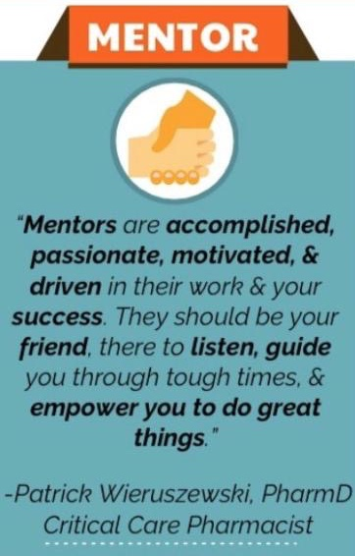
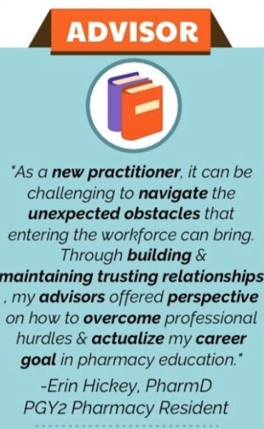
Types of Professional Relationships
Barlow B, Barlow A. Identifying the different types of professional relationships: Are you my mentor? Am J Health Syst Pharm. 2020;77(18):1463-1465.
Notes:
All play an important role, but these roles differ greatly. Let’s review how each relationship helps drive you toward success:
Mentor: mentors are experienced, highly regarded, empathetic individuals that guides the mentee’s personal and professional development and support career planning. Mentors are essential relationships to guide the career choice, personal development, and goal achievement of individuals, interpersonal compatibility is key for the mentor to support and shape the mentee’s pursuit of his or her ambitions and career plans, a mentor will serve to clarify their mentee’s visions, share their personal experience, and create strategic plans on how the mentee can successfully achieve them.
Advisor: an advisor is an Individual who gives direction on a particular subject by jumpstarting an advisee’s thought process and providing knowledge, tools, and resources. Unlike mentors, who guide, advisors direct

Slide 29
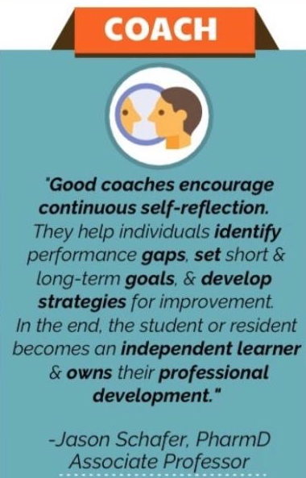
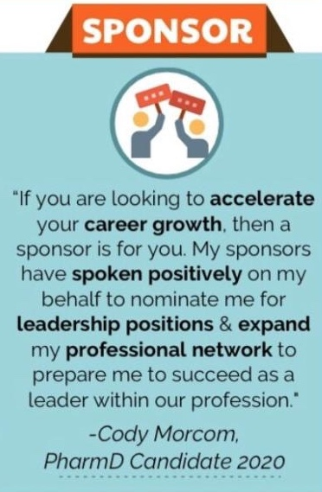
Types of Professional Relationships
Barlow B, Barlow A. Identifying the different types of professional relationships: Are you my mentor? Am J Health Syst Pharm. 2020;77(18):1463-1465.
Notes:
Coach: help the learner identify and address gaps in his or her skill set and build habits that move the learner toward a desired level of competence in selected areas; do not simply inform learners on what or how to improve, but instead they empower their learners to become self-reflective to identify areas for growth and the habits that will lead them to improve. Preceptors are often a coach to students when on rotation.
Sponsor: individuals with legitimate and referent powers and influence who serve a crucial role in escalating the career growth of their sponsee; sponsors do not provide guidance to their sponsees on personal matters, but rather, help them garner success within professional environments. Sponsors are also known as “career expanders”. A prime example of a sponsor is someone who writes a letter of recommendation on your behalf.. Such as when you apply for a residency.
Keep in mind some individuals may end up fulfilling multiple roles…. Or even move between roles throughout your career.

Slide 30
Where can you find mentors and advisors?
State/Local
Pharmacy
Association
Pharmacy
Residents
Rotation
& Residency
Preceptors
Established Pharmacy Leaders
Faculty or Student Society Advisors
Any Successful Person
Anywhere Pharmacists Practice
Notes:
I have listed some here on the screen but would like to hear from you. Does anyone in the room have a mentor? Where did you find your current mentor?
I like to encourage students to look for variety -- choose
One who has achieved a professional level you aspire to achieve
One who has recently undergone the challenges you are about to face
Engage with them in a meaningful way.
Associate with winners.

Slide 31
Effective Mentees
Trust mentor
Responsible for own growth and development
Prepared for meetings
Respect mentor’s time
Understand qualities you are seeking to develop
Willing to apply change (open minded)
Goal-Oriented
Seek challenges
Take initiative
Ask lots of questions
Transparent
Notes:
Remember that relationships are bidirectional… they require involvement and investment from both parties… What can YOU do to be a good mentee?
Ask question and get responses for first minute of this slide, then bring in the answers.
So, to wrap up mentoring there are some key pearls you need to remember:
You need to formally ask someone to be your mentor and assist you with your career. Might start with a simpler request – advice on a specific point; then another or a couple of other requests—before you ask (this is kind of like trying on the relationship for both)
Ask the following 5 questions about the person you select:
Are they doing what you aspire to do?
Are they well respected by their peers?
Do you feel comfortable with them?
Do you trust your conversations will be kept in confidence?
Are you willing to be candid and work hard to get the most out of it?
Ask someone here to be your mentor (say “I am xxx, and I want to be a leader”).

Slide 32
Step 4: Build Leadership Skills
Administrative
General
Clinical
Notes:
3 core areas
Before we look at the next few slides, let’s throw out some ideas that come to mind when you consider skills that would be important for a managerial role versus clinical role and what leadership skills are just generally important for all of us to build…. (discussion).
Have you developed these in SOP?

Slide 33
Learn To Manage Yourself
Emotional Intelligence
Self-awareness
Self-regulation
Motivation
Empathy
Social skills
Work effectively with others
Build healthy habits
Make time for yourself and practice self care
Notes:
Develop time management, writing, & speaking skills
All about how you go about doing your job; your style

Slide 34
Learn to Manage Yourself: Books
Notes:
There are tons of leadership books out there, and several focused on building emotional intelligence and learning to manage yourself… Here are just a few

Slide 35
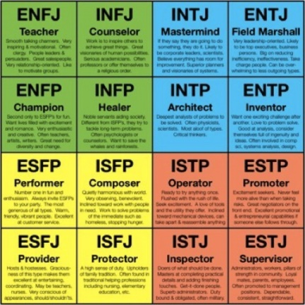
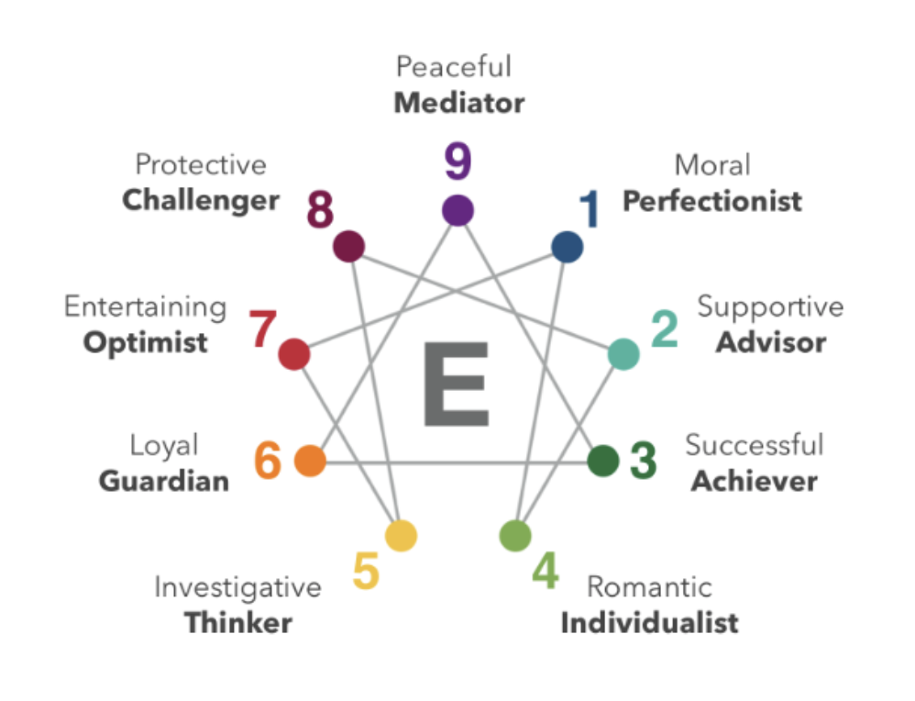
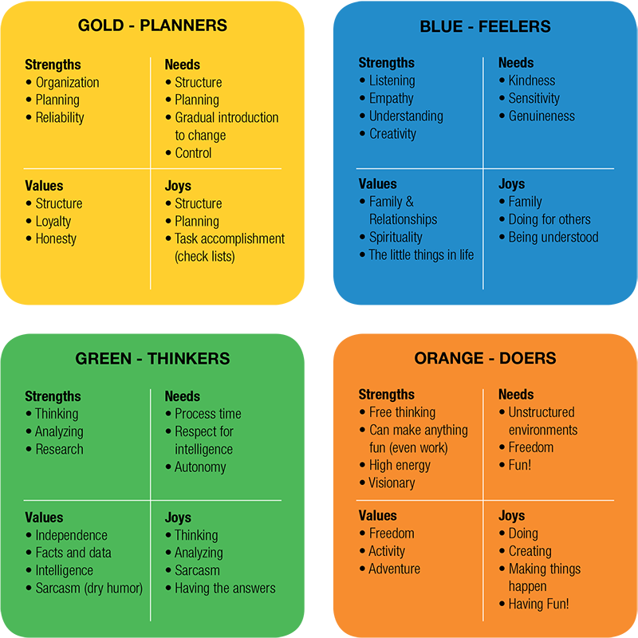
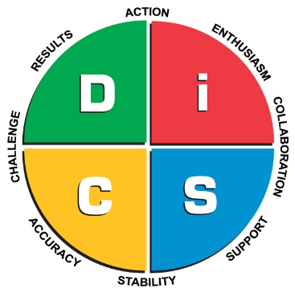
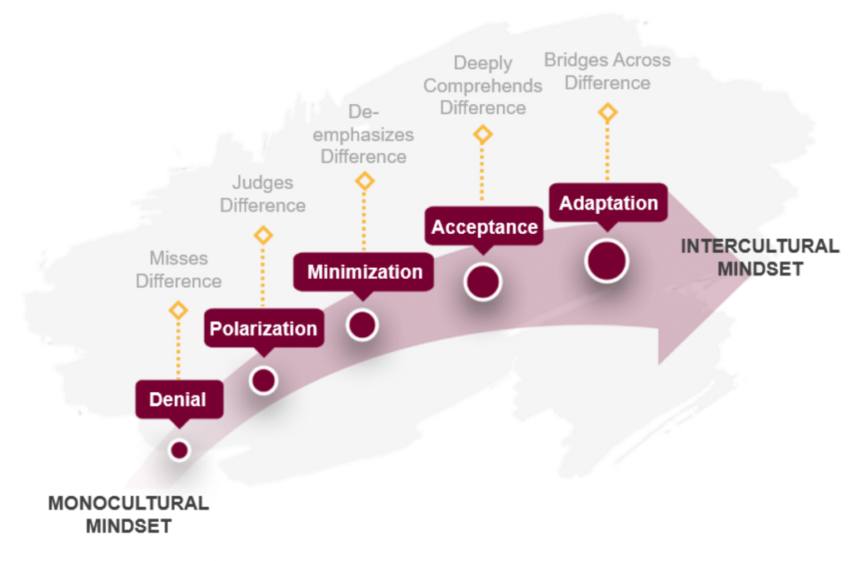
Learn to Manage Yourself: Assessments
Myers-Briggs
True Colors
Intercultural Development Inventory (IDI)
Notes:
Another way you can build you self-awareness and learn to manage yourself is by completing self-assessments. There are several commonly used, including
Myers Briggs
Strengths Finder
Enneagram
True Colors
DiSC
(among many others…)
You may also want to consider the Intercultural Development Inventory (IDI) to improve your cultural awareness

Slide 36
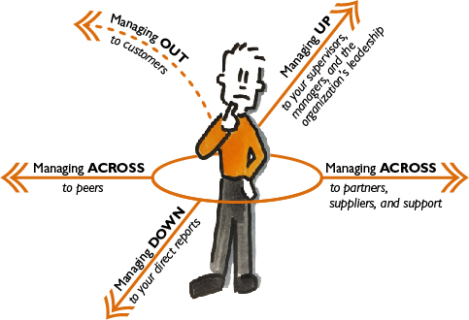
Managing Up, Down, Across and Out
Managing Across:
Managing Down:
Be:
Proactive
A team player
Professional
Trustworthy
Establish:
Trust
Record of competence
Dependability
Be:
Reliable
Consistent
Fair
Do:
Mentor others
Lead by example
Provide feedback to help others develop
Managing Up:
Be familiar with the department’s Mission, Vision, and Strategic Plan
Understand your boss’s:
Strengths / weaknesses
Preferred style of decision-making and receiving information
Prioritize expectations and advocate for the most important
Negotiate mutual expectations
Self-Reflect:
Understand your strengths, weaknesses, work style, and needs
Focus on dependability and honesty
Appreciate your boss’s goals and pressures
White SJ. Leading from a staff or clinical position. Am J Health-Syst Pharm. 2009; 66: 2092-2096.
Gabarro JJ, Kotter JP. Managing your boss. Harvard Business Review. 1993; 71: 150

Slide 37
Key Leadership Skills
Connection & Belonging
Self-Organizing
Strong Ethics
Nurtures Growth
Efficient Learning
Giles S., The Most Important Leadership Competencies, According to Leaders Around the World. Harvard Business Review. 2016.
Notes:
Survey of 195 global leaders found that these were the Top 10 Leadership Competencies Grouped Into Five Themes:
Strong ethics and safety
Self-organizing
Efficient learning
Nurtures growth
Connection & belonging

Slide 38
Where can you learn these skills?
Administrative
General
Clinical
Notes:
Note the similarity of skills between all 3. You are not exclusively a clinical leader or an administrative leader. Become well rounded so you can move between roles without fear of failing because you have only worked as a clinical leader or an administrative leader to date.
So, we just covered a lot of skills for you to build! Where in the world will you be able to take a class or read a book that can teach you all that? Well, you can’t.
But there is good news – our profession has created the ideal training program for you.

Slide 39
Advanced Training is Critical
A pharmacy residency is an organized, directed, post-graduate training program that centers on development of knowledge, attitudes, and skills necessary to function as a competent practitioner.

Slide 40
Do you plan to complete a residency?
YES
MAYBE
NO
Show of Hands
Notes:
How many of you are planning or considering residency training upon graduation?
Very good. Well, we are going to get to know each other even better throughout this workshop today

Slide 41
Motivation to Consider Residency Training
Residencies develop leaders
Apply skills learned in school
Learn from experienced practitioners
Career flexibility through broad experiences
Self-awareness through feedback and coaching
Refine general leadership skills
Time management
Communication
Organizational skills

Slide 42
Pharmacy Residencies
Post Graduate Year One (PGY1) Residency
Hospital, Ambulatory and Community Pharmacy Practice
Provides broad clinical knowledge, some exposure to leadership
Post Graduate Year Two (PGY2) Residency
Clinical specialty (i.e. Emergency Medicine, Pediatrics, Infectious Disease, Oncology, etc)
Pharmacy Administration, Informatics, Medication Safety
Provides intense, focused training
PGY1 & PGY2 Administrative Residency +/- Master’s Degree
Intense clinical AND administrative training along with a Master’s Degree in Health-System Pharmacy/Community- Based Administration (or equivalent degree)
Notes:
It is called a residency. A residency is not simply an extension of a Pharm. D. Rather, you should think of it as a “BRIDGE” between school and actual practice.
A residency is not continuing education, rather, it is “knowledge application.” The difference from being a student to being a resident is the level of “accountability” for taking care of patients and independent problem solving. You don’t go from being a student on June 30, to a competent clinical pharmacist on July 1. A residency helps you quickly develop those “competency” skills that take several years to develop in a job.
Pharmacy school focuses on “education”, while a residency is “training” and assessment of “competency” in practice.
There are a couple types of residencies. There is the post-graduate year one, or PGY-1. These are 1-year programs in hospitals and ambulatory care settings where you will gain general pharmacy practice skills. After completion of the PGY-1 you will have an option to complete a specialty residency or PGY-2. These programs provide more intensive, focused training on either a clinical specialty or in an administrative capacity. There are also combined programs that offer a joint Master’s Degree program.

Slide 43
Health-System Pharmacy Administration & Leadership (HSPAL) Residency Programs
Combined PGY1/PGY2 program or PGY2 program
Build upon the PGY1 competences of delivery of patient-centered care and pharmacy operational services
Strive to prepare future leaders who can assume high level managerial, supervisory, and leadership responsibilities
Example areas of focus during the program include:
Safe and effective medication-use systems
Quality assurance and improvement
Management of human resources
Management of financial resources
Use of technology
Notes:
HSPA residency programs have been developed and increased over the years in response to the impending “Leadership Crisis”
Now that you have heard about the leadership crisis, who do you think will step up to the plate?

Slide 44
Community-Based Pharmacy Administration and Leadership Residency Programs
Combined PGY1/PGY2 program
It provides strong foundation in patient care and create leaders to advance patient care services in community and ambulatory care settings.
Example areas of focus during the program include:
Clinical and Operational Management
Quality, Safety and Process Improvement
Finance and Budgeting
Human Resource Management
Leadership

Slide 45
Why Consider a Career in Pharmacy Administration…
Opportunity to influence patient care on a large scale
Ability to lead important initiatives to advance the pharmacists scope of practice
Ability to influence direction, funding and implementation of clinical programs
Seek challenging and rewarding experiences that can lead to the growth and development of others
Make a difference in the lives of our patients!

Slide 46
Clinical & Administrative Pharmacist Career Paths
Pharm.D.
PGY1
Residency
PGY2
Residency
You Are Here
General Practitioner
Specialty Practitioner
Dotted lines will gradually disappear for pharmacists in patient care and leadership roles
Notes:
I like to share this diagram with students because I often get the question, “Is a residency really necessary?” Yes, if you want a meaningful practice!
Let’s start at the red “You are here” bubble. You are about to graduate with your PharmD and you want to become a specialist. The truth is you could theoretically follow the dotted line path and get there-- eventually. However, the length of time it would take you to get there would likely be significantly longer than the residency-trained pharmacist AND the dotted line path is gradually disappearing. Imagine that you are the hiring manager…all else being equal, do you choose the residency-training candidate or the non-residency-trained candidate?

Slide 47
Questions

Slide 48
Supplemental Resources
ASHP Foundation Leadership Resources www.ashpfoundation.org/Leadership
The Leadership Resource Center www.ashpfoundation.org/LeadershipResources
Pharmacy Leadership Academy and Pharmacy Leadership Institute http://www.ashpfoundation.org/PLA http://www.ashpfoundation.org/MainMenuCategories/CenterforPharmacyLeadership/PharmacyLeadershipInstitute
Sara White’s Work
White SJ, Enright SM. Is there still a pharmacy leadership crisis? A seven-year follow-up assessment. Am J Health Syst Pharm. 2013;70(5):443-7. Available at: http://www.ajhp.org/content/70/5/443
White SJ. Will there be a pharmacy leadership crises? An ASHP Foundation Scholar-in-residence report. Am J Health Syst Pharm. 2005;62(8):845-55. Available at: http://www.ajhp.org/content/62/8/845
Sara White’s blog on ASHP Connect: http://connect.ashp.org/blogs/sara-white
Notes:
ASHP Foundation Leadership Resources (www.ashpfoundation.org/leadership) – This site offers many useful resources such as access to the Pharmacy Forecast Reports, as well as collections of relevant lectures, videos, and webinars.
The Leadership Resource Center (www.ashpfoundation.org/LeadershipResources), includes a Leadership Primer (foundational concepts), Self-Assessment (offering personal insight), Leader’s Tool Kit (worksheets, tips, etc.), and Focused Learning Modules (for in-depth self-study on key topics).
Pharmacy Leadership Academy and Pharmacy Leadership Institute links from the main page will also provide valuable information on specific programs that aspiring leaders can use to develop their skills as their careers progress. As we discussed today, it’s always beneficial to start planning your goals now.
Sara White is one of the most prolific leadership consultants, whose work looks at what leadership opportunities and needs the profession will be facing over the coming years, as well as what being a leader in today’s market entails. Besides her contributions via articles she also maintains a blog (http://connect.ashp.org/blogs/sara-white).
John W. Webb Award Lectures The award is given in recognition of for excellence in pharmacy management, and many of the accompanying lectures speak to the recipients’ leadership skills and advice. (www.ashp.org/menu/AboutUs/Awards/WebbAward/Webb-Award-Lectures)
ASHP Resource Centers (www.ashp.org/menu/PracticePolicy/ResourceCenters) offers a variety of links to audience, and topic specific resources, including student and leadership resources.
Pharmacy Practice Model Initiative (PPMI) aspires to transform how pharmacists care for patients by empowering the pharmacy team to take responsibility for medication-use outcomes. It is a model that will require leadership to succeed. More information can be found at: www.ashpmedia.org/ppmi.

Slide 49
Supplemental Resources
John W. Webb Award Lectures www.ashp.org/menu/AboutUs/Awards/WebbAward/Webb-Award-Lectures
ASHP Resource Centers www.ashp.org/menu/PracticePolicy/ResourceCenters
Pharmacy Practice Advancement Initiative (PAI) https://www.ashp.org/Pharmacy-Practice/PAI

