Slide 1
Fostering Women Leaders in a Knowledge Café
March 4, 2015
4-5:30 pm ET

Slide 2
Fostering Women Leaders
The challenges are well known: women in business continue to face a formidable gender gap for senior leadership positions. Moreover, there are fewer and fewer women at each step along the path, although they represent the majority of entry level employees. Barriers are too well known: cultural factors, ingrained mindsets and mindlocks, and stubborn forms of behavior, including a tendency to tap a much narrower band of women leaders than is possible given the talent pool.
McKinsey. Fostering women leaders: a fitness test for your top team. January 2015

Slide 3
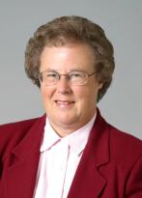
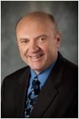
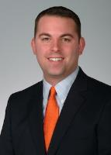
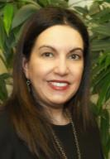
Our Expert Panel
Sara White
Michael Powell
Chris Fortier
Noelle Chapman
Desi Kotis

Slide 4
Leading in a World of Change
What is driving change & molding future work?

Slide 5
Slow Pace of Fast Change
“Gradually, then suddenly”
Inability to grasp exponential change
Staying aware is a challenge
Notes:
See WHY NOW? Section of Artificial Intelligence meets the C-suite

Slide 6
6 Key Change Drivers
Longevity
Technology
World as a programmable system
Media literacy
Organizational redesign
Global connectivity
Notes:
Longevity: People are living longer; by 2025, the number of Americans over 60 will increase by 70%
Technology: Smart machines will augment and extend our own capabilities; workplace automation is killing repetitive jobs
Living in a computational world: Increases in sensors and processing makes the world a programmable system; data will give us the ability to use things on a scale that has never been possible
New media ecology: New communication tools require media literacies beyond text; visual communication is becoming the new vernacular
Superstructured organizations: Social technologies will drive new forms of production and value creation (Friedman NYT July 2011: Being a highly trained and skilled professional will not be enough; each employee will need to bring new value to the organization every day.)
Global connectivity: US & Europe no longer hold a monopoly on market power, innovation & opportunity
Backdrop 2 McKinsey Quarterly Reports: Management Intuition for the next 50 years and Artificial Intelligence meets the C-suite.

Slide 7
Changing How We Act & Think
Sensemaking
Adaptive thinking
Cross-cultural competency
Computational thinking
New media literacy
Transdisiplinary focus
Design mindset
Cognitive load management
Social intelligence
Notes:
The combination of data and analytics growing exponentially to fill the gap: the human brain cannot conceive of and process the level of complexity that we increasingly face. What skills are needed in the future as we envision it
See The Future of Work: 10 skills you will need to be successful
Sensemaking: Ability to determine deeper meaning or significance of complex change and to develop options for moving forward
Adaptive thinking: proficiency at thinking and coming up with solutions and responses beyond that which is rote or rule-based
Cross cultural competency: Ability to operate in different cultural settings
Computational thinking: Ability to translate vast amounts of data into abstract concepts and to understand date based reasoning
New media literacy: Ability to critically assess and develop content that uses new media formats and to leverage these for persuasive communication
Transdisciplinary: Literacy in and ability to understand concepts across multiple disciplines and to integrate oppositional thinking
Design mindset: Ability to represent and develop tasks and work processes for desired outcomes
Cognitive load management: Ability to discriminate and filter information for importance and to understand how to maximize cognitive functions
Virtual collaboration: Ability to work productively, drive engagement and demonstrate presence as a member of a virtual team
Social intelligence: Ability to connect to others in a deep and direct way, to sense and stimulate reactions and desired interactions

Slide 8
Why Focus on Developing Women Leaders?
Talent
Demographics
Pragmatic realities

Slide 9
Women Continue to be Underrepresented as Senior Leaders
Sources: Bureau of Labor Statistics (2011), EEOC Employer Information Report for Hospitals (2011), American Hospital Association (2010), American College of Healthcare Executives (2013).
Notes:
Perhaps the largest talent pool we are not fully leveraging: women.
74% of healthcare workforce (Bureau of Labor Statistics, 2012)
Source: http://www.bls.gov/cps/wlf-databook-2012.pdf
71% of mid-level officer and management positions (EEOC Employer Information Report for Hospitals, 2011)
54% of executive and senior officer positions (EEOC Employer Information Report for Hospitals, 2011)
24% of senior executives (AHA, 2010)
18% of hospital CEOs (ACHE)
Collective Source: Changing Healthcare by Design: Critical Career Inflection Points for Women Healthcare Executives. ACHE 2013 Congress on Healthcare Leadership.
Take Away: Women are not making it to the top. Why?

Slide 10
Is There Still a Glass Ceiling?

Slide 11
Have you experienced or observed the glass ceiling phenomena in your career?
YES
NO

Slide 12
Is There Still a Glass Ceiling?

Slide 13
Factors Valuable to Career Success
Women cited specific factors as more helpful to their careers than men did, including:
Leadership abilities
Involvement in professional or community organizations
Networking within their organizations
Having sponsors to endorse them
Access to flexible work practices
Support from family members
Notes:
In order to do a better job of tapping into women as potential leaders, we have to better understand factors impacting their success in the workplace.
Diversified’s research ask men and women healthcare leaders to indicate factors they believe have either helped or challenged their career advancement. Responses clearly differed by gender.
Women in all cohorts surveyed—all healthcare leaders, C-suite executives, and CEOs—rated access to flexible work practices significantly higher than their male peers. In fact, men at all levels of leadership consistently rated access to flexible work practices at the bottom of their list.
That said, when asked to report how much family life impacts their work, men reported much higher rates of conflict than women. Perhaps this is due to the fact that women not only value access to flexible work practice but are also more likely to leverage them

Slide 14
Challenges to Career Advancement
Women identified challenges to career advancement:
Lack of supportive supervisors
Exclusion from informal networks
Lack of senior role models “like me”
Inhospitable culture/biased attitudes
Failure of senior leadership to help advance someone “like me”
The need to prioritize family over work
Men identified different challenges to career advancement:
Unwillingness to change organizations / companies
Having an ineffective leadership style
Lack of significant general or line management experience
Notes:
Women rated these 6 factors as more significant obstacles to career advancement than their male counterparts.
Men rated only these 3 factors higher than the women did in terms of their impact on career advancement.
Diversified research also showed men perceived their willingness to relocate throughout their careers as more beneficial than their female counterparts; yet the same research shows relocation is significantly more helpful for women’s career advancement than men’s .
Possible explanations:
perhaps women who are willing to relocate get “rewarded” with promotions to a great extent than men because it is less likely to happen;
Perhaps it takes a major promotion to entice women to relocate whereas men may be willing to relocate for lateral job opportunities.
Take Away: Women identify external challenges to their career advancement, while men identified internal limitations as the most significant challenges to advancement

Slide 15
Career Paths
Women are more likely to be promoted internally than hired externally.
Notes:
A significantly greater number of women than men in Diversified’s research were promoted from within their organizations than hired externally, Men reported the opposite.
Possible Explanations:
Survey showed men are more willing to relocate for jobs than women--perhaps because women, if married, are more likely to have spouses with full time jobs; women reluctant to uproot children.
Literature consistently suggests subtle bias in hiring process—women judged by performance, work she’s done while men are judged by potential.
Take Away: This mentality (a) makes it more likely that a woman will be promoted within her organization where her work is known and (b) suggests it is easier for men to be hired into other organizations.
This internal versus external dynamic has financial implications for individuals and the organization.
In Diversified research study, external hires earn $389,500 on average, while internal hires make $364,567 on average. These are not statistically significant differences, but do reflect the impact of internal versus external hiring on a person’s salary.
The average cost of replacing one leader with an external candidate, at minimum, is approximately $50,000 — a cost that could reach as high as $1.5 million for a CEO. Source: Hospitals & Health Networks magazine, https://www.besmith.com/thought-leadership/white-papers/10-questions-comprehensive-succession-planning
Take Away: External hires cost significantly more and are paid significantly more. Meanwhile,
research by Wharton School of Management shows senior leaders hired from the outside have less tenure in their roles and perform lower when compared to internal promotions.
Other research by Booz & Co. showed 35 percent of the externally hired CEOs were let go versus 19 percent who were promoted from within.

Slide 16
What About the Glass Cliff?
A senior job or important project, particularly one given to a woman with a high risk of failure

Slide 17
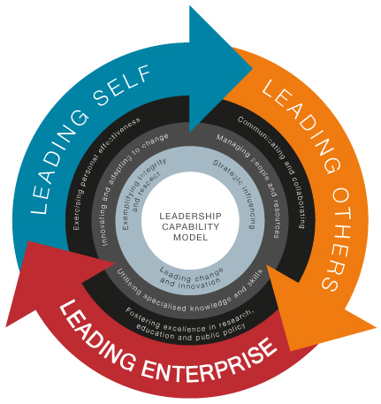
Notes:
Fundamentally comes down to:

Slide 18
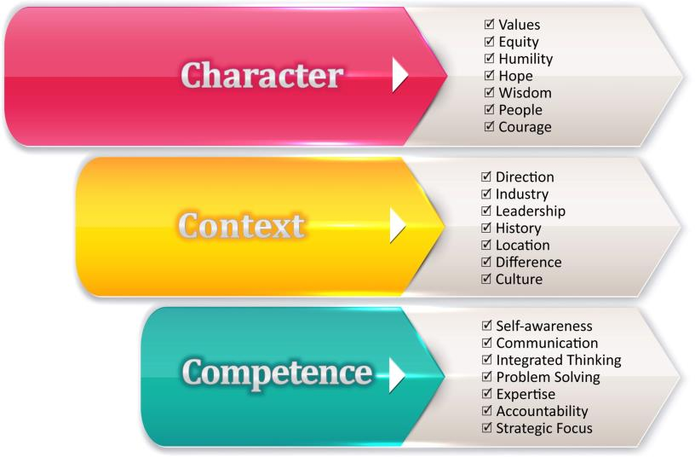
Authentic Leadership

Slide 19
Gender Bias: Socialized or Personal
Leadership competencies for a changing healthcare world
Relationships
Empathy
Humility
Control, or not
Gender bias
(In)Visibility & disappearing acts
Microinequities
Bottom Line
Women (and men) excel with opportunity. Nurturing opportunity may be an issue . . .

Slide 20
Have you felt or observed gender bias in the workplace?
YES
NO

Slide 21
Leadership Competencies Where Men are Perceived to Excel
Problem analysis/resolution
Effective communication
Bridges to external environment
Innovation

Slide 22
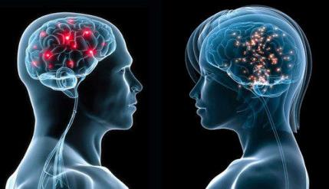
Leadership Competency Differences
Where Women Excel
Where Men Excel
Initiative
Integrity, honesty
Drives for results
Develops others
Inspires, motivates
Relationship building
Collaboration, teamwork
Champions change
Establish stretch goals
Technical expertise
Strategic perspective
Zenger, Folkman

Slide 23
What? More Women?
Many factors you might think would be predictive of group performance were not. Group intelligence had little to do with individual intelligence.
Women’s social sensitivity is higher. And team diversity – of every type -- is essential.
What Makes a Team Smarter? More Women . . .
Woolley & Malone
HBR, Jun 2011
Notes:
There is little correlation between a group’s collective intelligence and the IQs of individual members but if a group includes more women, its collective intellingence rises according to MIT based Woolley and Malone.
What if you could measure the intelligence of a group? Or predict which team assigned to design a horse would end up with a camel or a thoroghbred . . . Or a race car?
This MIT group’s focus is on theories of group performance, integrating social psychology, group dynamics, crowdsourcing, computer science and their own research in group behavior. After a series of studies, Malone reports: “If there were more women, the group performed better. In general, the higher the ratio of women to men, the better the performance. 50 50 had the worst scores. More women than men, the best scores. The conclusion: women function extremely well in the teaming function and the team and organization benefit from that skill.
For a profession among healthcare professions that are female dominated demographically, this is not a bad thing, but surely a dynamic to be on your radar.

Slide 24
A Fitness Test for Your Top Team
Where are the women in our talent pipeline?
What skills are we helping women build?
Do we provide sponsors along with role models & mentors?
Are we rooting out unconscious bias(es)?
Are our policies helping or hurting?
McKinsey. Fostering women leaders: a fitness test for your top team. January 2015

Slide 25
How We Encourage Aspiring Women Leaders . . .

Slide 26
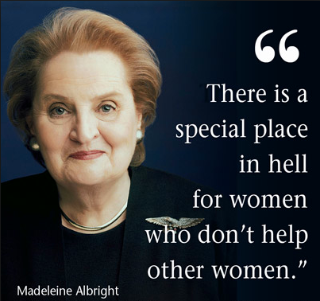

Slide 27
Recruiting and Retaining Women Leaders
Is the role a defining issue?
Do women bring a different mindset to negotiation?
Salary Issues
Fair market value
The process
Benefit issues
Stories . . .

Slide 28
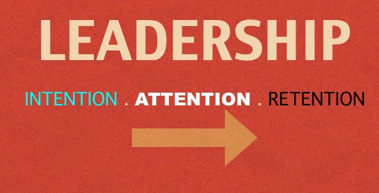

Slide 29
Dual Career Issues

Slide 30
Succession Planning

Slide 31
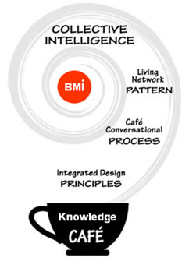
WELCOME TO THE KNOWLEDGE CAFÉ
Nothing is more powerful than sharing knowledge and creating innovative approaches for critical issues . . .
Pull up a chair; Sit down and talk; Listen and learn. You might be surprised at the outcome. . .
WIL

Slide 32
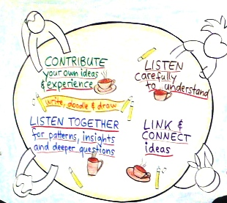
KNOWLEDGE CAFÉ ETIQUETTE
Contribute thoughtfully to the dialog
Listen
to learn
for perception differences
to reflect
together for shared meaning
Link and connect ideas
Jot notes & Doodle on the Table

Slide 33
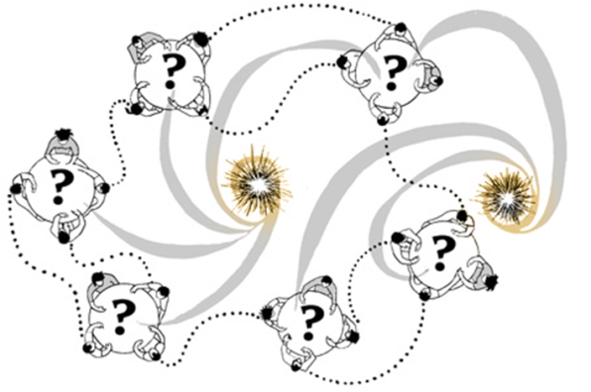
Agenda and Discussion Flow
4 thought provoking presentations
followed by open, creative dialog to share ideas and understanding
Host will focus dialog segments on powerful questions (20 min x 3)
Table host remains
Thought ambassadors migrate
Harvesting ideas

Slide 34
Dealing with Tangles: If We Only Knew What We Know

Slide 35
Resources
Additional information is available on the website at
http://www.ashp.org/knowledge_cafe
References
Speaker contacts
Slides
Knowledge Café Instructions & Resources

