Slide 1



Tips for Residency Applicants: Using PhORCAS and the Match
Amanda Grant, PharmD
H. Mir, PharmD
Notes:
Mir:
Welcome to ASHP’s webinar on PhORCAS
Our names are Amanda and Mir and we’re the 2025-2026 Executive Fellows at ASHP.
This webinar will provide an overview of the application timeline and tips for PhORCAS for students.

Slide 2
Objectives
Establish expectations concerning the process of residency recruitment
Understand functionalities of PhORCAS to assist you with submitting residency applications
Explain the Two-Phase and Post Match Processes
Understand how PhORCAS and The Match operate
Identify pointers to help you effectively navigate the application portal in PhORCAS
Notes:
Mir:
At the end of this presentation we hope you’ll be able to…. <<READ BULLETS>>
We hope that you will be able to gain a better understanding of both PhORCAS and The Match and be able to navigate the applicant portal of PhORCAS by the end of this presentation.

Slide 3
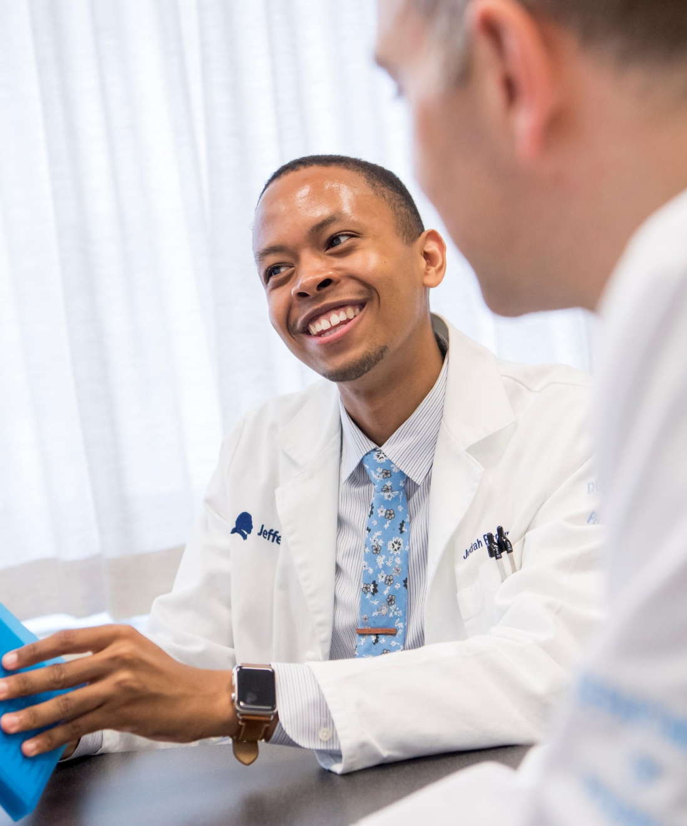
Quick Residency Application Process Review
Apply to Residency
Interview
Rank/Match
Notes:
Amanda:
For those new to the residency application process, or if you need a refresher, I’d like to quickly review with you how it works.
By this point, you should have a list of programs you’re interested in applying to. If not, you can look up the ASHP Residency Directory to review available programs.
During the application process, you will apply through the PhORCAS system. We will review this process in detail during the rest of this presentation.
The second step of the process is scheduling interviews. Sites will begin contacting qualified candidates after their deadlines have passed to schedule interviews. Remember, you are interviewing the program as much as they are interviewing you so make sure to ask questions.
Finally, once you have completed the interview, you will need to rank any program you’re interested in doing your residency at during the Ranking process. If you dislike a program, please do not put them on your list. We will review the match in further detail later on in this presentation but please remember that the Match is a binding agreement. Where you match is where you will be doing your residency.

Slide 4

ASHP Role in Residency Training
Accreditation
Midyear Clinical Meeting
Residency Showcase
Personnel Placement Service (PPS)
Education sessions concerning the residency recruitment process, use of PhORCAS, and what to expect
PhORCAS
Representatives from Liaison International will be in the exhibit hall for questions
The Match
Notes:
Mir:
ASHP is heavily involved with the residency training process through our Accreditation Services Office that works on accrediting residencies and contracts with PhORCAS for Residency Applications.
At the Midyear Clinical Meeting, you will see that ASHP supports the residency process through events like the residency showcase, the personnel placement service (also known as PPS), and various residency recruitment educational programming including sessions concerning the recruitment process, use of PhORCAS, and what to expect during the application process.
Additionally, there will be representatives from Liaison International in the exhibit hall if you have any additional questions about the PhORCAS portal.
Educational Sessions occur on Sunday at Midyear during Student Programming if you’d like to attend a live session to learn more.

Slide 5

Goal
Streamline the residency recruitment process wherever possible to benefit:
  Residency applicants
  Residency programs
  Reference writers
Notes:
Amanda:
The ultimate goal of PhORCAS is to streamline the residency recruitment process wherever possible to benefit residency applicants, residency programs, and reference writers.

Slide 6
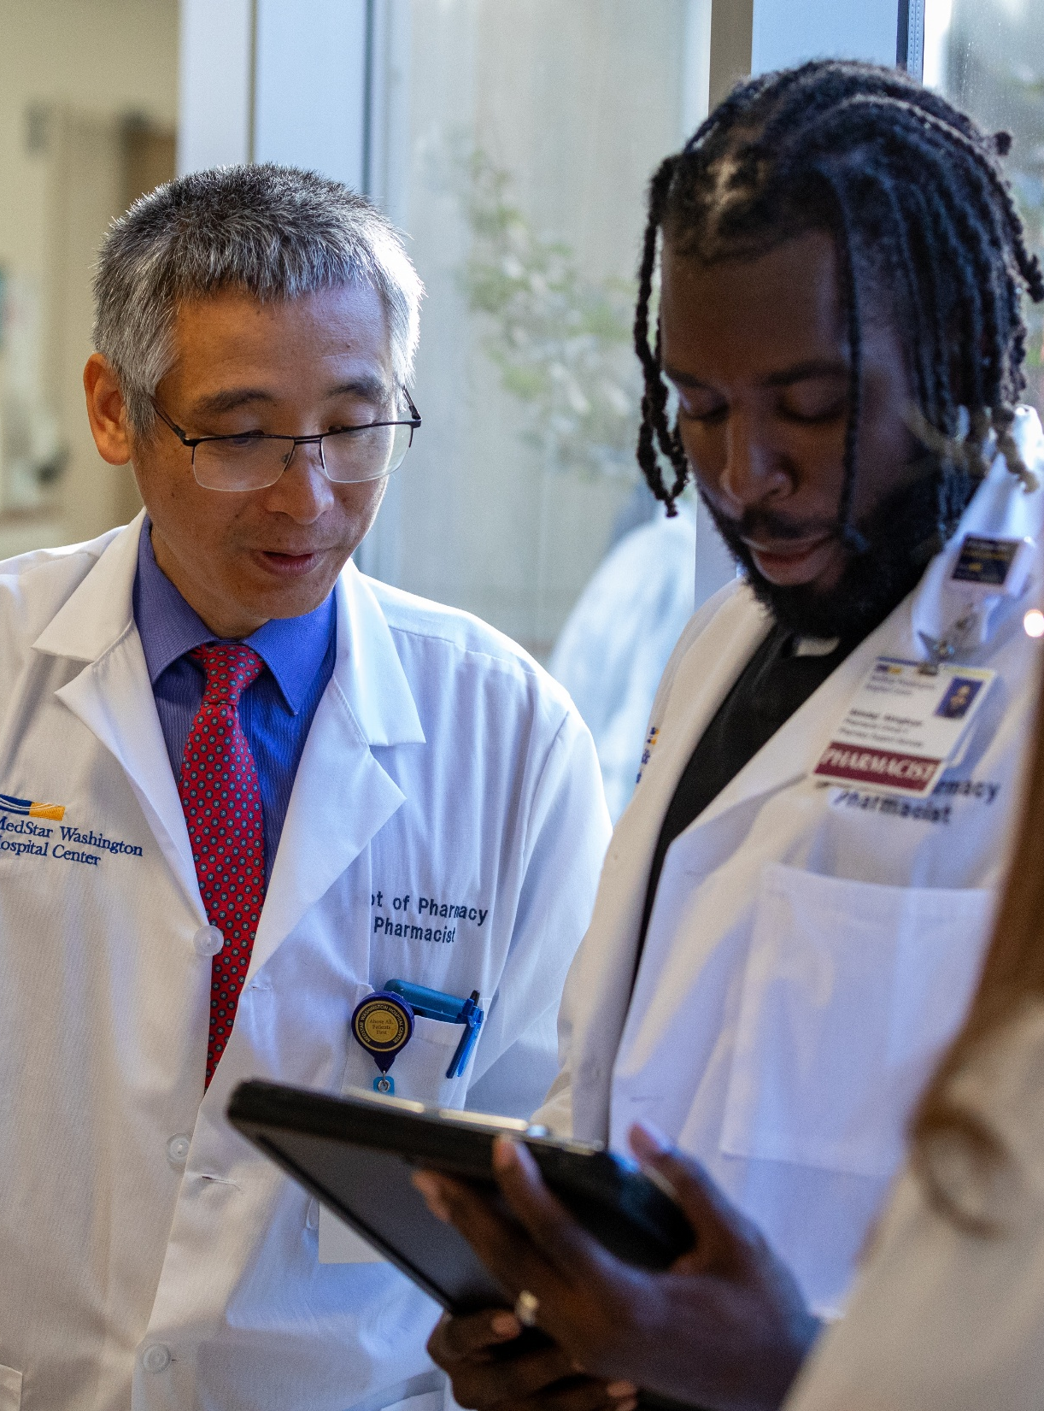
The Basics
PhORCAS is the result of a partnership between ASHP and Liaison International
Streamlines the residency application process
Similar to ‘PharmCAS’ that is used to pharmacy school applications
Notes:
Amanda:
The Pharmacy Online Residency Centralized Application Service (also known as PhORCAS) is the platform that helps automate the entire residency application process, following ASHP’s guidelines & requirements.
PhORCAS is a product of Liaison International, a Boston company that specializes in centralized application services including PharmCAS, used by many of you in the admission process for pharmacy schools.

Slide 7

Applicant Portal
Application
  Applicant/personal information
  Academic Records
  Program Evaluations
Upload personal statement
Upload CV
Select references
Site-specific supplemental requirements
Notes:
Mir:
There is an applicant video tutorial that goes through how to access and use the portal. It is a good idea to review the video before you apply.
This presentation will focus more on the components of each section of the application process.
If you have any site-specific questions, it should be directed to PhORCAS. We will provide the email at the end of this presentation.
There are various components that interface within PhORCAS, but for the purposes of this presentation, we will be focusing on the Applicant Portal.
The applicant portal includes <<READ BULLETS>>
The application itself which is where the applicant can enter personal information, academic records and program evaluations.
The portal is also where the applicant will upload a personal statement, upload a CV, Select references, and address site specific supplemental requirements.
We will review each of the listed components in the following slide.

Slide 8
Applicant Process
Create Account
Update Application Information
Upload Documents
Select 3 References
Submit Application
Notes:
Amanda:
As mentioned, the application process for residencies occurs through the PhORCAS portal. To complete it, you have to follow several steps:
Step 1 -Create a PhORCAS account and sign up for the National Matching Service (more commonly referred to as The Match)
Step 2 -Fill in the application information requested in your profile, even if it is included in your CV. Here you will request official transcripts from your school via PhORCAS.
Step 3 –Upload your CVs, cover letters, and any site-specific documents (such as essay questions, questionnaires or other requirements as outlined on the website of the residency of your interest).
Double check that all your documents are final, labelled appropriately, and free of errors prior to uploading
Step 4 -Select references that apply to your programs of interest – typically it is three references, but programs may request additional ones based on their application requirements. Reference writers will fill out a form on the PhORCAS portal.
Step 5 -Submit the final application to your selected sites
One online profile submission will be disseminated to multiple programs. Make sure that all uploaded documents that are personalized to your program are labeled correctly, to avoid confusion during the dissemination process.
The platform allows electronic tracking, to notify you of the application progress. You will know exactly what application components are pending and which reference writers have not submitted letters of reference.

Slide 9
Cost
Program | Cost
National Matching Service | $160 Flat Fee
PhORCAS (up to 4 applications) | $110
Each additional application | $43
Ex: Wilber wants to apply to 10 residency programs
  Wilber will pay $160 to NMS
  Wilber will pay $368 to PhORCAS {$110 + ($43 x 6)}
Notes:
Mir:
Remember, the National Matching Service and PhORCAS are two different entities by two different companies. Both fees need to be paid to allow access to the portal and submission to the residency match.
The base fee is $160 for the National Matching Service. This is a flat fee regardless of the number of applications or number of rankings that you submit and allows you to access the Match.
There is an additional PhORCAS fee of $110 that covers up to 4 program applications. This fee is also standard regardless if you are applying to just one or all four programs.
- If you are interested in applying to more than 4 programs, each additional application is $43.

Slide 10
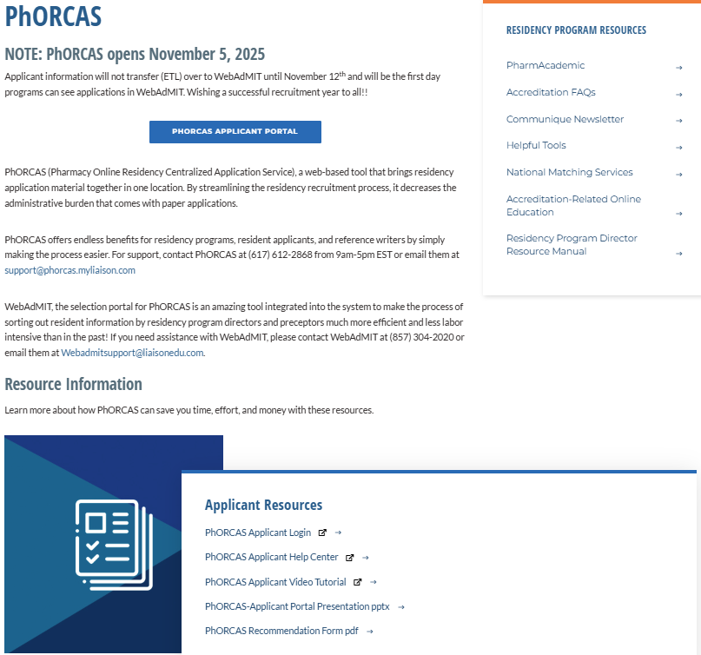
Access this page at: https://www.ashp.org/phorcas
Login here
Notes:
Amanda:
To initiate the process and access PhORCAS, start by visiting the website.
This webpage provides all the information you need about the application process and assistance with selecting and submitting for residency programs.
Once in the page, scroll down, under resource information, → applicant resources and click on ‘PhORCAS Applicant login’ – this will direct you to the online application portal.
Please note the date that PhORCAS opens, which is located at the top of this webpage. For this cycle, PhORCAS will open November 5th, 2025.

Slide 11
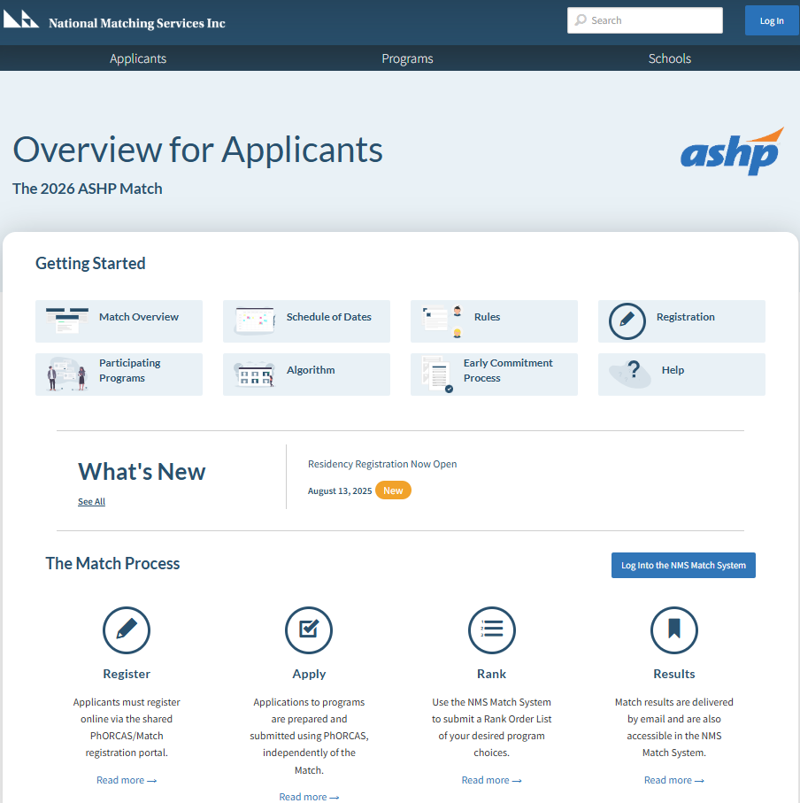
Start by Creating a New Account
Access this page at: https://natmatch.com/ashprmp/applicants/index.html
Notes:
Mir:
Here is a screenshot of the main page you will see as a student on the National Matching Services website.
As you may notice across the bottom, there are four main links.
Register: which will allow you to register online for PhORCAS and the Match.
Apply: Apply to your programs of interest
Rank: This allows you to rank your programs
And finally, results: Here you can review the results of the match

Slide 12
Sign-On Tips
Do not create more than one account
  If you have problems, do not start over. Contact PhORCAS staff if you need additional assistance.
Trouble signing-on? Check that you are using the correct portal link!
  Applicant Portal: https://phorcas.liaisoncas.com/
Reference Portal: Individual links for each reference
Notes:
Amanda:
Now I will go over tips to help you with your application …..
First, make sure you do not create more than one account. If you have any issues, do NOT start over. Contact PhORCAS for additional assistance.
If you have trouble signing on, make sure to check that you’re using the correct portal link as shown on the slide.
Each of your reference writers will have a different link, with their own sign on code to enter their reference information on an individual. You do not need to request a letter of recommendation from your reference writers unless a site you’re applying to specifically asks for a letter.

Slide 13
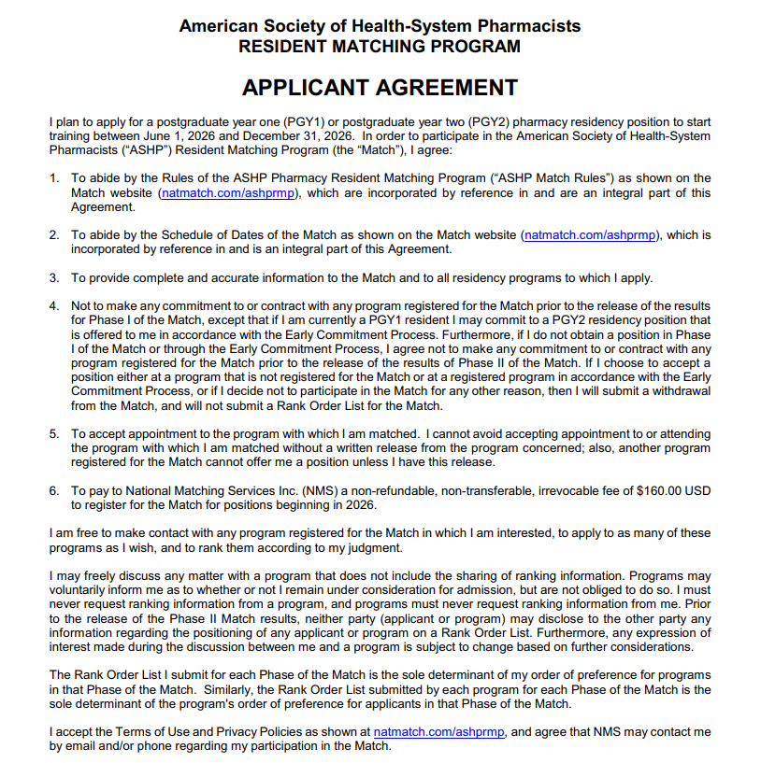
ASHP Match Rules & Eligibility
Each applicant must accept the binding Match Agreement when they register to participate in the Match
Make sure to read it thoroughly
Notes:
Mir:
Before entering the match, you must complete the applicant agreement listed on this page. Make sure you read it thoroughly to understand the conditions of participation in the match. As a reminder, each applicant must register to participate in the match.
This is a binding agreement. Later on in this presentation, we will discuss the Match in more detail.
Once you have reviewed the NMS materials carefully, the sign-up process occurs within PhORCAS. You will pay your PhORCAS and NMS fees described in a previous slide through PhORCAS.
DO NOT READ:
https://natmatch.com/ashprmp/documents/applterms.pdf

Slide 14

Application Materials
National Matching Service (NMS) Code
  Must register for NMS before submitting applications in PhORCAS
    While NMS and PhORCAS are two separate entities, when entering the PhORCAS site originally, you will be transferred seamlessly to NMS to register/receive the code
  Automatically sent to you from NMS when you register and kept in your PhORCAS application
Notes:
Amanda:
Before we begin, let’s review some of the application logistics.
Your personal NMS applicant code will be provided after you register for the match online.
When you get your NMS number, a tip would be to include it in your CV so that the residency program can access that information easily
Note: each residency program has its own program NMS code

Slide 15
Application Materials (cont.)
Application Deadline
  Unique to each program
  All materials must be submitted to program by that date
  Take care of all aspects of the applications that is under your control as early as possible
  No new application will go through after 11:59 PM EST on application deadline
  PhORCAS will allow transcripts and reference to go through late as long as the application is in by the deadline
    Programs may or may not honor these late deliveries
  Each program can adjust deadlines accordingly
    Can open and close window before or after
    No program can close their date prior to Jan 2
Notes:
Amanda:
Another important component to note is the application deadline.
The portal to accept applications is controlled by the program and each program may have a different deadline requirement
Make sure to do your research beforehand
Deadlines are important, be cognizant
No new applications will go through after 11:59 PM EST on the application deadline
Don’t wait until last minute → If you wait until last minute and have trouble uploading… you may miss the program’s deadline
The things you cannot control can come in later- transcript and references.
You can still e-submit your application if your transcripts and reference are not uploaded yet
Programs can open and close their application window at any point

Slide 16
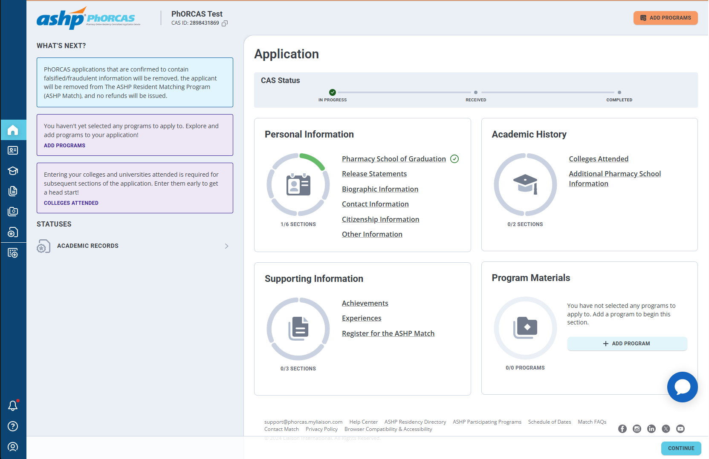
PhORCAS Home Page
Notes:
Mir:
Now, we will dive deeper into PhORCAS.
When you first log in, this is the home page. We will now review each section.

Slide 17
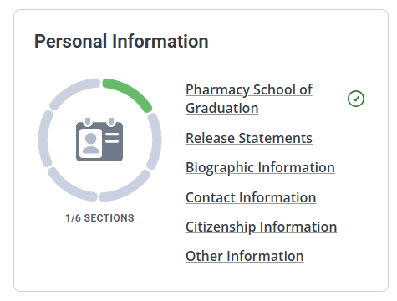
Personal Information
This section of the application only needs to be completed once and is saved for all programs you submit to
Collects important information including address, phone, email, citizenship information, etc.
Notes:
Mir:
For the Personal Information part of your application, you will only need to complete this once. The information is saved to your profile and will be submitted to each program that you apply to. Make sure this information is up to date and accurate since this is the only time you will be asked to input this information.
Make sure the email you use is up to date and is one that you check daily since most communication will come to the email provided.

Slide 18
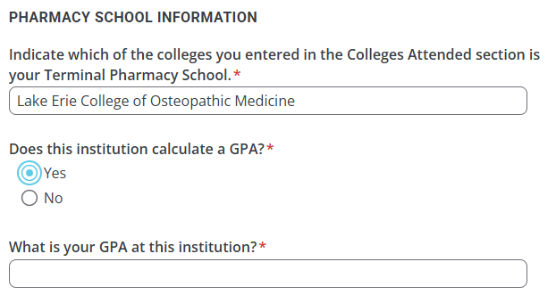
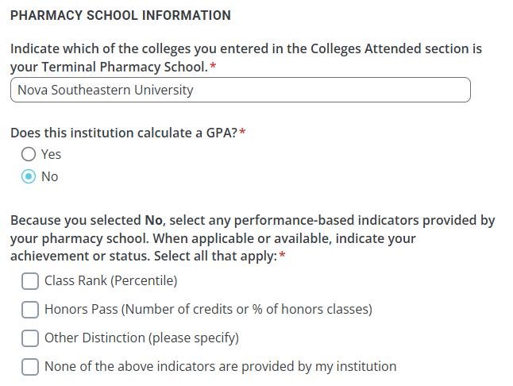
Academic History
This section of the application will collect your Colleges Attended information
  You’ll be able to request transcripts to be sent to PhORCAS under this section
  Only Pharmacy School transcripts are required
Additional Pharmacy School Information
  You’ll be required to list your terminal Pharmacy School
  Report if your school collected a GPA, Class Rank, Honor Percentile, etc.
Notes:
Amanda:
In the Academic history section, you will fill out the Colleges Attended and Additional Pharmacy School Information.
You can request a copy of your transcripts to be sent directly to PhORCAS through the application process. If your Pharmacy School is from a foreign program, you will be contacted by PhORCAS to submit that information.
Only pharmacy school transcripts are required
If your program has special requirements or a master’s component, please check and send in ALL of the transcripts they are looking for. For example, many programs combined with a masters may require all undergraduate transcripts.
TIP: Do not wait to request your transcripts, as this may impact the timing of your application.
Although most pharmacy schools are aware of the process, some schools may take awhile to get transcripts in by due dates. The holidays can also play a factor in the delay of submitting your transcripts so make sure you are on top of asking your school for your transcripts.
Make sure to be proactive, you don’t want to delay your application because you are waiting for the school to send transcripts.
If an updated transcript is requested by a program later, you can request it again.

Slide 19
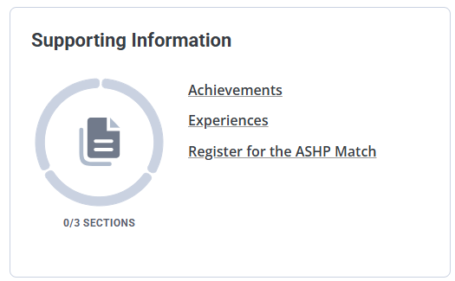
Supporting Information
Achievements you wish to share with your programs
  Publications
  Scholarships
  Awards
  Presentations
Experiences you would like to share with your programs
  Internship
  Leadership Experiences
  Pharmacy Work Experiences
  Volunteer
Entering this data allows programs to search through candidates easily
Use your CV to complete this section!
Notes:
Mir:
In the Supporting Information section, you will add any additional information that you want programs to see. These include achievements and experiences that you worked on in pharmacy school.
In this slide, we have provided a list of examples for you to include in your application.
Make sure to fill out all the extracurricular and professional activities you have done in these sections; remember residency programs might be looking for something specific and may skip over you, even though it is included in your CV and not in this section of PhORCAS
As an FYI, some programs use this data to sort through applications, so it is better to fill it out, to improve your chances at matching

Slide 20
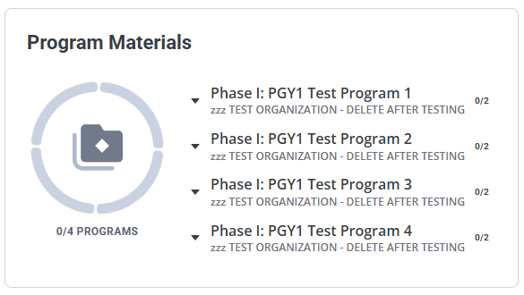
Program Materials
Any programs of interest that you add from the “Add Programs” tab will appear in this section of the home page
Each program page consists of 3 subsections
  Details
  Documents
  Program Evaluations
Notes:
Amanda:
In the program materials section, you are able to add any programs of interest that you have.
This is utilized to help you keep track of the site-specific requirements for each program.
Before submitting your application, you may add or remove programs at any time.
On each program page, you will find 3 subsections
On the details page, you will find more general information about the residency program.
This is where you will find the Program’s specific deadline and supplemental documents for their residency applications, their Match Code Number, and their contact email for site-specific questions.
You will also find the Documents page. We will review this in more detail on the next slide.
The final subsection is the Program Evaluations.
This is where you can send your reference requests. We will also review this in further detail later in the presentation.

Slide 21
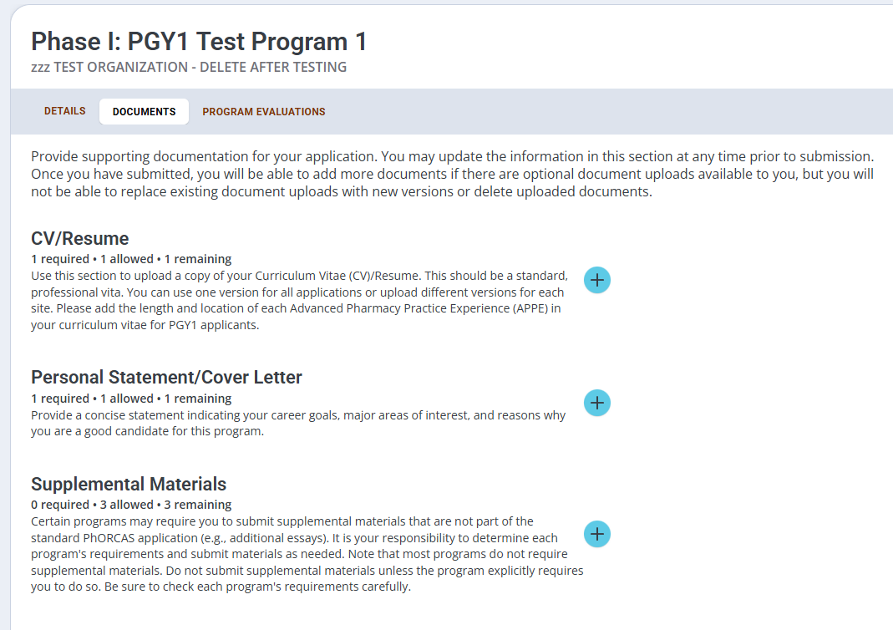
Program Materials - Documents
Upload your CV/Resume, Personal Statement/Cover Letter, and up to 3 Supplemental Materials
  Supplemental materials are not required! If your program requires any additional uploads outside of what is collected in PhORCAS, this is the place to upload that document
Notes:
Amanda:
Under the program materials, within the documents tab, you will be able to upload your CV, Personal Statement or Cover Letter, and any Supplemental Materials you have for your site.
Make sure your documents are uploaded as a PDF or a Word document.
PhORCAS can handle all PDF uploads except dynamic PDFs, password protected ones, or PDF portfolios.
You may use a standard CV for all of the programs you’re applying to.
If you would like to customize your CV for a program, make sure you are uploading the correct file to the appropriate program.
Your Cover Letter should be individualized for each program you’re applying to. We will review this in more detail in the next slide.
Supplemental materials are optional, only include it when a program specifically asks for it. Only give the programs what they want to see, they may not appreciate extra materials to review!

Slide 22

Program Materials – Personal Statement/Cover Letter
Personal Statement, Cover Letter, or Letter of Intent (LOI)
  Should be customized to each program
  Create separate personal statements for each program you apply to
    File name recommendation: LastName_FirstName_LOI_Program
  Identify if special questions need to be answered
Notes:
Amanda:
The Personal Statement (also called a Cover Letter or Letter of Intent), should be customized to each individual program since each program is unique in what it may offer.
It is best practice to save each letter you write with your name and the program information to make it easier to locate and upload to the appropriate section on PhORCAS.
Programs are able to download your files for review so be sure to keep the file names professional. We have provided an example in the slide.
Make sure to always double check the document you are uploading.
As you are writing your letter, be sure to identify if there are any special questions that need to be answered.

Slide 23
Reference Writer Communication
Three references per program are required in PhORCAS
  Some programs may require an additional reference
Notify references before selecting them in PhORCAS
  Communicate what programs you are applying to
  Discuss the following scenarios with them:
    If the reference writer is familiar with the program and wants to send a personalized reference, they can add comments on the form
    You are applying to uniquely different programs and want the reference to have a different emphasis (ex. PGY1 and admin program)
  Let the reference writer determine if they want to write program-specific or unique form vs. the standard form that goes to all programs
If the site does not ask for a letter, the reference writer can NOT send a letter
Notes:
Mir:
3 references are required for each program you apply to.
You can select different references for each program, or use the same references for all programs, it is your choice.
PhORCAS can accept up to 4 references, but this should only be used by programs that require 4 references.
Only send the amount of references the program has asked for.
You are not limited on the amount of reference writers you can request in PhORCAS for different programs, but you are only able to submit 4 for each program.
Before sending reference requests, notify the individual that you would like them to be a reference.
Once they agree, provide them with your CV for reference and follow up appropriately.
Let them know the deadline(s) and if they need to provide any additional information for a program.
Make sure to ask them specifically what you want them to include or focus on (for example, leadership in an organization or clinical skills on a rotation)
References will be asked to answer questions using a scale and are able to provide open comments. We will look at this in an upcoming slide.
It is strongly recommended to notify each reference writer in a timely manner​ and provide them with ample time to fill out the references.
You will be able to see if they uploaded the reference, but you will NOT be able to review what it says.

Slide 24
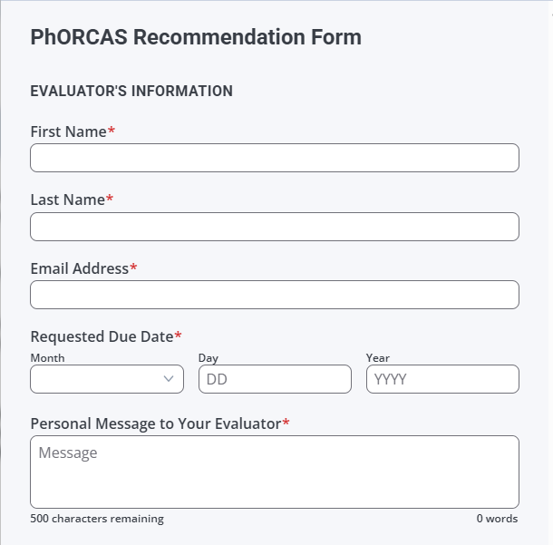
Requesting References in PhORCAS
Notify Reference Writer prior to requesting through PhORCAS
Make sure to communicate a deadline for the reference to be submitted
Include any personal messages you wish to share with your reference writer
Notes:
Mir:
As discussed on the last slide, make sure to notify your reference writer PRIOR to requesting it through PhORCAS.
Once they have confirmed, you can send them a request.
This is a screenshot of what the page looks like when you set up the reference request.
You have the opportunity to send a personal message to your evaluator which will save time on having to send them a separate email.
We recommend that you utilize this space to let them know the deadlines, specific information about the program, or items you want the reference writer to be aware of.
The “Personal Message” is only seen by your identified reference writer.
You can send multiple requests to each letter writer based on the specifications of each program.
Lastly, don’t forget to thank your reference writer!

Slide 25
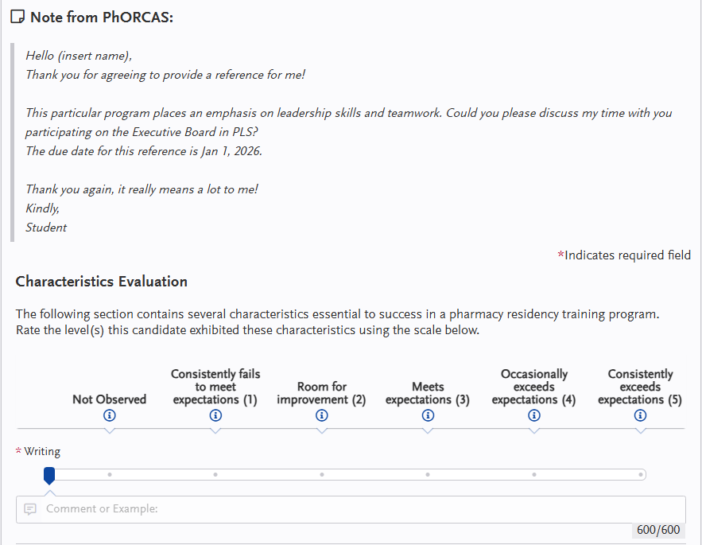
Sample Recommendation Form
Your personalized message will show here for your reference writer.
Notes:
Mir:
This is an example of the Recommendation Form that your reference writer will see when they log in.
This form gives reference writers the ability to promote you in a variety of areas.
The personalized message we discussed in the previous slide will show at the top of the evaluation.
Please note that some programs may also request a traditional reference letter in addition to this form.
Some examples of areas that your reference writers are able to promote are:
Writing skills
Oral communication skills
And many others
Again, do not request a traditional letter unless the program requires it.

Slide 26

2025 Statistics
6,772 registered for the match
5,973 participated in the match
Each applicant applied to an average of 10 programs
88.2% position fill rate (PGY1 and PGY2 combined data)
Notes:
Amanda:
Here are some of the statistics for the 2025 match.
If you are looking for more broken-down statistics from the past few years, please visit the ASHP Resident Matching Program portion of the National Matching Service website (https://natmatch.com/ashprmp/stats.html) for additional information

Slide 27

2025 Statistics
20,580 individual reference writers
62,340 references submitted
3,072 programs (1,707 PGY1, 1,310 PGY2)
5,962 available positions (4,259 PGY1, 1,703 PGY2)

Slide 28
The Match
Notes:
Amanda:
Now that we’ve discussed the application process, we will go over submitting for the match process.
There are multiple phases of the Match that we will review in upcoming slides.
As a reminder, after applications close, programs will begin reviewing candidates and sending out interview invites.
Please give them a few weeks to review.
Remember that you are interviewing the program just as much as they are interviewing you!
After interviews are complete, you will have the ability to rank your programs.
This list is your preferred residency site in order of favorite to less preferred.
Programs will also complete a match list, and the program will “Match” candidates with residency programs after the deadline for submitting your Rank Order List closes.
For PGY-2’s, there is a slightly different process.
Early commit programs do not have a uniform process
You will need to follow up with programs you’re interested in early committing for
There are also some combined PGY-1 and 2 programs
Some PGY-2 candidates will need to go to Midyear to look around at available programs
Some will interview at PPS

Slide 29
Timeline 2025-2026
Access the full updated schedule at: https://natmatch.com/ashprmp/schedule.html
November 5th, 2025 | Applicants can register in PhORCAS and sign up for NMS
March 6th, 2026 | Phase I MATCH: Rank order list due to NMS directly by 11:59 pm EST
March 18th, 2026 | Phase I MATCH: Results released Available positions for Phase II are posted beginning at 12:00 p.m. Eastern Time
March 23rd, 2026 | Phase II MATCH: Applicants still seeking positions can submit applications
March 30th, 2026 | Phase II MATCH: Rank order list can be submitted to NMS directly
April 15th, 2026 | Phase II MATCH: Rank order list due to NMS directly (Rank Order Lists for Phase II MATCH cannot be accepted after this date.)
April 22nd, 2026 | Phase II MATCH: Results released List of programs with available positions after Phase II of the Match will be provided on the Match web site beginning at 12:00 p.m. Eastern Time. Applicants who do not obtain a position in the Match will be able to use PhORCAS to prepare applications to programs that have positions available.
April 23rd, 2026 | Applicants can submit for post-match positions starting at 12pm EST, and sites can review these applications.
Notes:
Amanda:
This is an example timeline for the upcoming 2025-2026 Match.
Please note this list does not have any information for specific program or deadlines.
The full master schedule is located on the website shown on the slide.
Please also refer to the individual programs for final dates.
For the 2025-2026 Residency Application cycle, the National matching service and PhORCAS opens for applicants on November 5th

Slide 30
2025 Match (Programs Starting in 2026) Conducted in Two Phases
Phase I:
All applicants and programs submit their Rank Order Lists by the Rank Order List deadline for Phase I of the Match.
The matching algorithm will be processed using those Rank Order Lists to place applicants into positions. The results of Phase I of the Match will then be distributed to applicants and programs.
Notes:
Mir:
Again, after interviews, candidates and programs are able to submit their Rank Order Lists before the deadline for Phase I of the Match.
Once the deadline passes, the matching algorithm will use those lists to place applicants into available residency positions.
On Monday of Match week, candidates will receive an email stating that they have matched.
On Match Day, the results of Phase I will be distributed to applicants at 12:00 p.m. EST. Programs will have access slightly earlier than applicants.
We will go over important dates for Phase I later.

Slide 31
2025 Match (Programs Starting in 2026) Conducted in Two Phases
Phase II:
Programs with unfilled positions in Phase I of the Match will offer those positions to unmatched applicants in Phase II of the Match.
All applicants seeking positions after Phase I and all programs with available positions after Phase I submit their Rank Order Lists by the Rank Order List deadline for Phase II of the Match. A second match will be carried out using those Rank Order Lists, and the results of Phase II of the Match will then be distributed.
Notes:
Mir:
What if you don’t match in Phase 1? DON’T WORRY.
We will move onto Phase 2 of the Match.
Phase 2 will contain programs with unfilled positions.
A list of positions that are still available will be provided on the match website after Phase 1 is closed.
Candidates can submit applications in PhORCAS to apply for available programs.
The process is then repeated for Phase 2.
Participating in Phase 2 is not a bad thing! A lot of people match extremely well in Phase 2.
There are new programs and positions that receive funding AFTER Phase 1 of the Match so oftentimes, those will be added into Phase 2.
There are also applicants who do not participate in Phase 1 but may decide to participate in Phase 2 and there are programs that specifically hold positions for Phase 2 of the Match.
Most importantly, do not lose hope.

Slide 32
Post Match: The Scramble
After the results of Phase II of the Match are released, a Post-Match process will be implemented, in accordance with ASHP Match Rules, to assist applicants who are still seeking a residency to be placed into programs with positions available.
PhORCAS Adds Structure to the Scramble
  List of programs with available positions after Phase II of the Match will be provided on the Match web site beginning at 12:00 p.m. Eastern Time. Applicants who do not obtain a position in the Match will be able to use PhORCAS to prepare applications to programs that have positions available
  Programs will be able to update information on positions available after the Match on the Match website
Notes:
Mir:
After Phase 1 and 2 of the Match, a list will be released with programs that still have positions that need filling.
This third part of the Match is called The Scramble.
If you did not Match in Phase 1 or 2, you may participate in the Scramble.
Applicants will be able to continue to use their PhORCAS to apply to open positions until Late May. After that, residents will need to contact sites on their own.

Slide 33
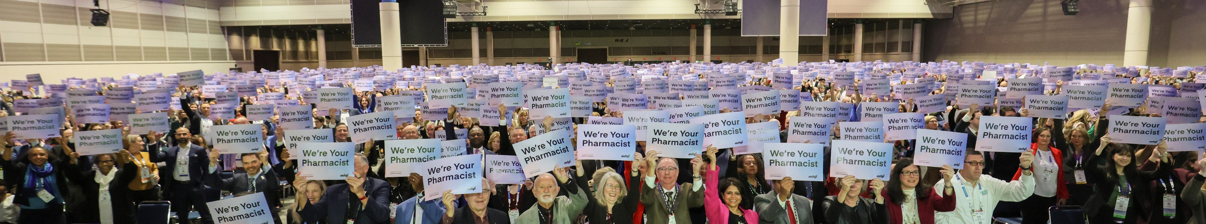
Tips and Tricks

Slide 34
Tips and Tricks
Trouble Logging In?
  There are different portals for applicants, reference writers, and programs
Do NOT create more than one account
  Contact PhORCAS Customer Service if you are having issues
Avoid special fonts and symbols when uploading documents
  Stick with Times New Roman or Arial
Check the FAQs for more information
  https://www.ashp.org/-/media/assets/professional-development/residencies/docs/092425-PhORCAS-ASHP-FAQ-doc9252.pdf
Notes:
Mir:
Next, we will discuss some common questions people have had over the years.
If you’re having trouble logging in, check to make sure you’re using the correct portal.
There are different portals for applicants, reference writers, and programs.
There are also portals that could still be active from previous years. Make sure you picked the correct portal for this year’s application and match.
We want to re-emphasize to not make a new account on PhORCAS. If you are having trouble, please contact PhORCAS Customer Service.
When uploading your documents, avoid special fonts and symbols. It is best practice to use Times New Roman or Arial.
If you have any other questions, make sure to refer to the FAQs
There are a variety of tips that are updated annually on the PhORCAS website

Slide 35
Tips and Tricks (cont.)
Unaccredited residency programs and fellowship programs are not in PhORCAS
  Only ASHP-accredited and those in the ASHP accreditation process seeking accreditation (pre-candidate & candidate) use PhORCAS
Reference writers use the standard PhORCAS form to submit their support
  Do not send a separate reference letter if not required
Foreign graduates
  New Visa
  Must be pre-approved
  Need proof of either pharmacist license or FPGEC from the NABP
Notes:
Mir:
Unaccredited residency programs and fellowship programs do not use PhORCAS for their applications.
PhORCAS will only have accredited residencies and those that are in the process of gaining ASHP accreditation status.
Reference writers will use the standard PhORCAS form to submit their recommendation.
For Foreign graduates, you must be preapproved to apply to PGY1 residency programs.
You must upload proof of either a Pharmacist License (RPh) from the United States or a Foreign Pharmacy Graduate Equivalency Committee Certificate (FPGEC) from the National Association of Boards of Pharmacy (NABP)

Slide 36
Tips and Tricks (cont.)
Do not wait until the night of the deadline to e-submit your application
  If you have trouble uploading last minute, you may miss the program’s deadline
  Consider getting applications in early to allow sites to review your application in more detail
Register for ASHP Midyear
  https://midyear.ashp.org/
  Residency Showcase
    Know in advance when your desired programs are displaying, programs only display one time (Monday afternoon, Tuesday morning, or Tuesday afternoon)
    Programs are only scheduled to participate in ONE of the three session
    Don’t be disappointed, be prepared with your list!
Notes:
Mir:
One of the most important tips we can give you is to not wait until the night of the program deadline to e-submit your residency application.
If you have trouble uploading last minute, you might miss the program’s deadline
Submitting early will allow programs to start reviewing your application early and avoid any technical difficulties that could arise.
Lastly, we recommend going to Midyear!
The residency showcase will be a great chance to get in front of a RPD, pharmacist at the site, or current resident at the program you are interested in matching to!

Slide 37
Need More Information?
Website
  https://www.ashp.org/phorcas
  Includes a document covering frequently-asked questions
PhORCAS Help Center
  https://help.liaisonedu.com/PhORCAS_Applicant_Help_Center
Check the FAQs for more information
  https://www.ashp.org/-/media/assets/professional-development/residencies/docs/092425-PhORCAS-ASHP-FAQ-doc9252.pdf
Student Residency Guide
  https://www.ashp.org/Professional-Development/Residency-Information/Student-Residency-Guide
  You need to be an ASHP member to log in to view the residency timeline, FAQs, interview skills packet, and more!
Follow Us on Social Media
  Facebook → https://www.facebook.com/ASHPofficial
  X → https://x.com/ashpofficial
  Instagram → @ASHPOfficial
  LinkedIn → http://www.linkedin.com/company/ashp
Notes:
Amanda:
We went over a lot of information in this presentation.
If you have any questions or need more information, please refer to the links on this slide or our FAQ for assistance.

Slide 38
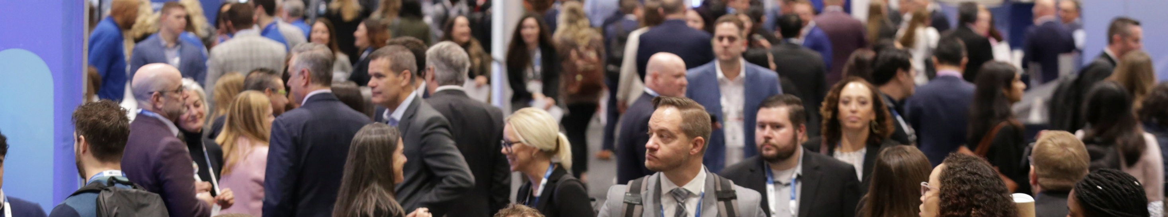
Questions about the platform?
Contact PhORCAS at support@phorcas.myliaison.com or call them at (617) 612-2868 from 9 am-5 pm EST

Slide 39
Notes:
Amanda:
Thank you for your time and good luck in finding the right match for you!

